Slide 1

Cooking with GCP and Splunk
Module 1 : Configuring GCP
Nic Stone | Solutions Engineer
Global Strategic Alliances Partner Integrations

Slide 2
Setting up GCP
Configuring GCP to collect and send data into Splunk
Permissions, Permissions, Permissions – GCP Service accounts and roles
Create a Google Cloud Service account (per project)
Add a role to each created service account
Setup GCP Cloud Billing
Setup GCP Cloud Monitoring (Stackdriver monitoring)
Setup GCP Pub/Sub (Stackdriver logging)

Slide 3
Setting up GCP
Important notes
Make sure you are in the right GCP project!
If something seems to be missing or looks off, double check that you are logged in with the right Google account and are in the correct GCP project.
Please create a GitHub Issue for any typos, bugs, issues, enhancement requests, etc.

Slide 4
Create a GCP Service account
Service account creation, custom role creation, role assignment, key creation

Slide 5
Table of Contents: Creating a GCP Service account
What’s in this section?
This section will walk through
Creating a GCP Role for Storage bucket listing
Creating a GCP Service account
Assigning the required roles to the GCP Service account based off what GCP services you plan to ingest into Splunk
Generating a JSON formatted key for later use in the Splunk Add-on for GCP
Editing GCP Service account roles
Generating new GCP Service account keys

Slide 6
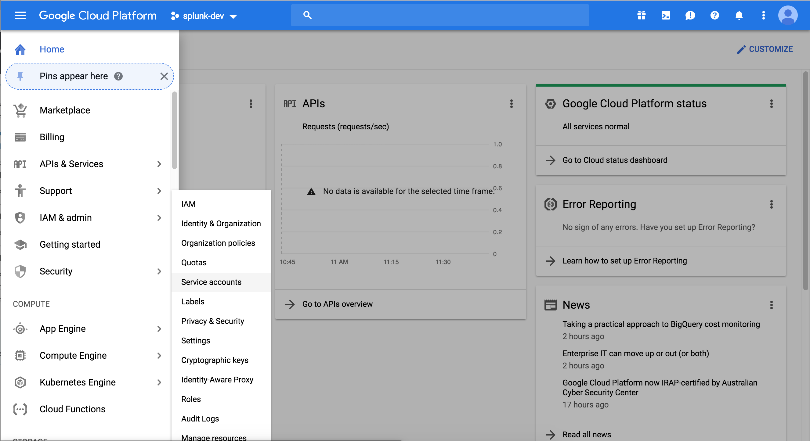
Creating a GCP Role for Storage bucket listing– Part 1
From the GCP Console Service menu, scroll to IAM & Admin, hover and click Roles
Here
Then click here
Notes:
Let’s start by opening the GCP menu, selecting IAM & admin and clicking on the Service accounts option on the left hand side.

Slide 7
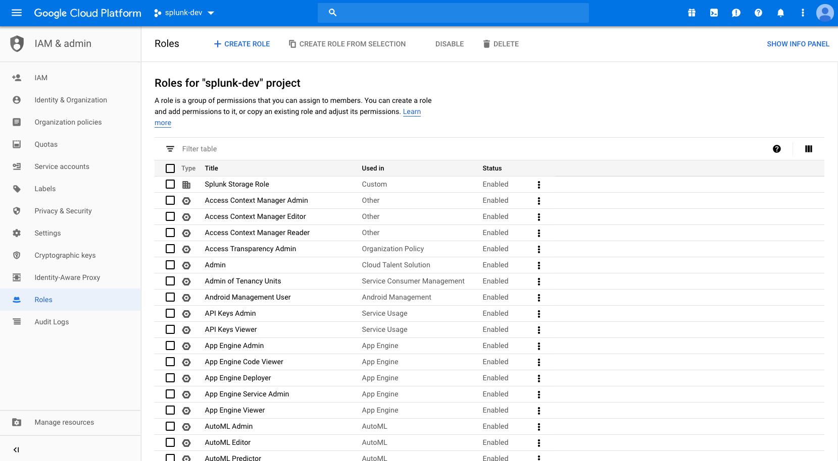
Creating a GCP Role for Storage bucket listing– Part 1
As of when this was published, GCP does not have an existing role for listing Cloud Storage buckets other than the the global read/write Storage Admin role. We will create a custom storage viewer role to accomplish this. Click Create Role.
Click here
Notes:
Let’s start by opening the GCP menu, selecting IAM & admin and clicking on the Service accounts option on the left hand side.

Slide 8
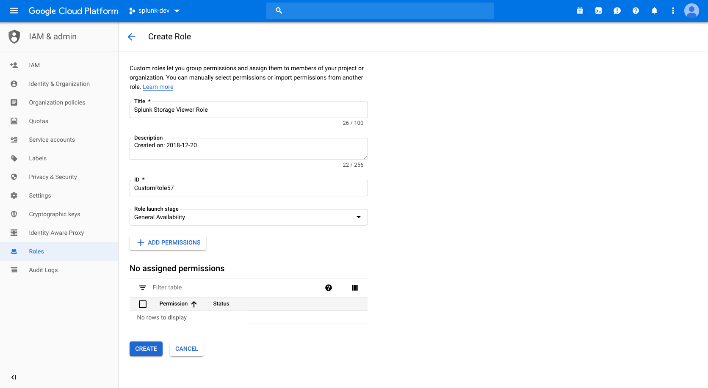
Creating a GCP Role for Storage bucket listing– Part 1
Provide a Title, Description, ID, and Role Launch Stage (General Availability as a default). Then click Add Permissions.
Click here
Notes:
Let’s start by opening the GCP menu, selecting IAM & admin and clicking on the Service accounts option on the left hand side.

Slide 9
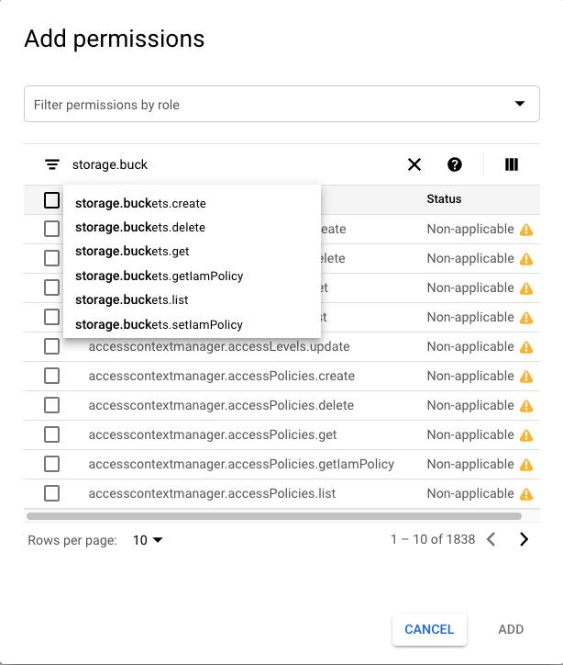
Creating a GCP Role for Storage bucket listing– Part 1
In the Filter table input (NOT the Filter permissions by role input), type storage.buckets.list
Filter here
Notes:
Let’s start by opening the GCP menu, selecting IAM & admin and clicking on the Service accounts option on the left hand side.

Slide 10
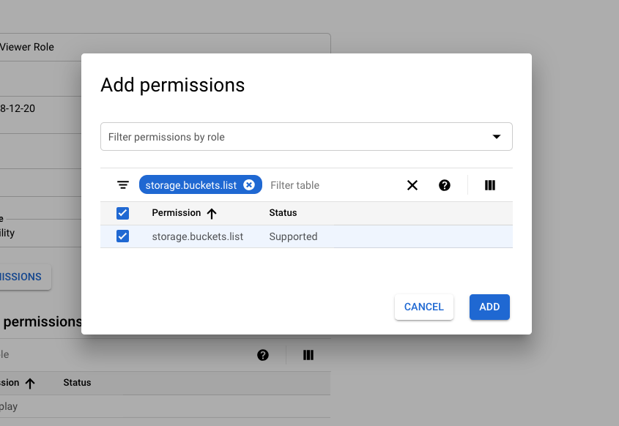
Creating a GCP Role for Storage bucket listing– Part 1
Select the storage.buckets.list checkbox in the permissions table, then click Add.
Select the checkbox
Notes:
Let’s start by opening the GCP menu, selecting IAM & admin and clicking on the Service accounts option on the left hand side.

Slide 11
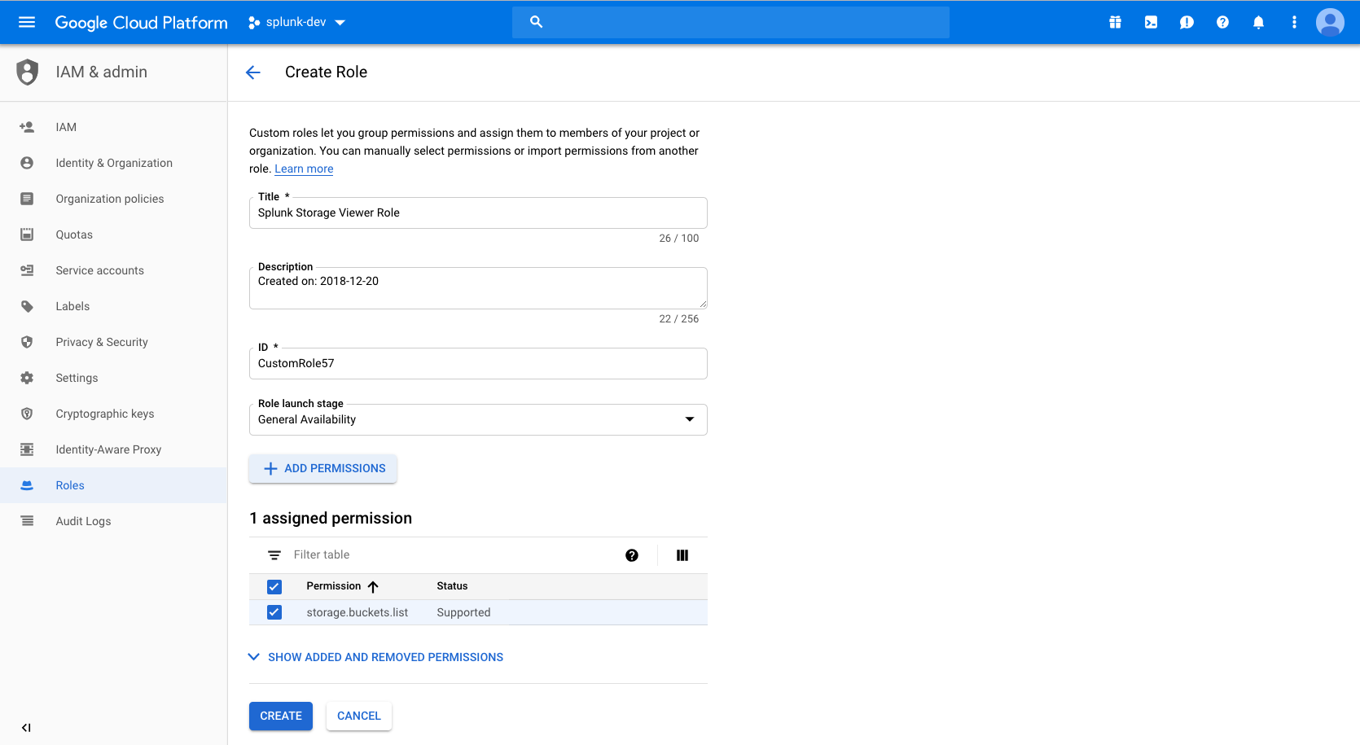
Creating a GCP Role for Storage bucket listing– Part 1
Confirm role settings, then click Create. Keep track of the name of this newly created role as you will need it in the next step.
Notes:
Let’s start by opening the GCP menu, selecting IAM & admin and clicking on the Service accounts option on the left hand side.

Slide 12
Creating a Service account – Part 2
From the GCP Console Service menu, scroll to IAM & Admin, hover and click Service accounts
Here
Then click here
Notes:
Let’s start by opening the GCP menu, selecting IAM & admin and clicking on the Service accounts option on the left hand side.

Slide 13
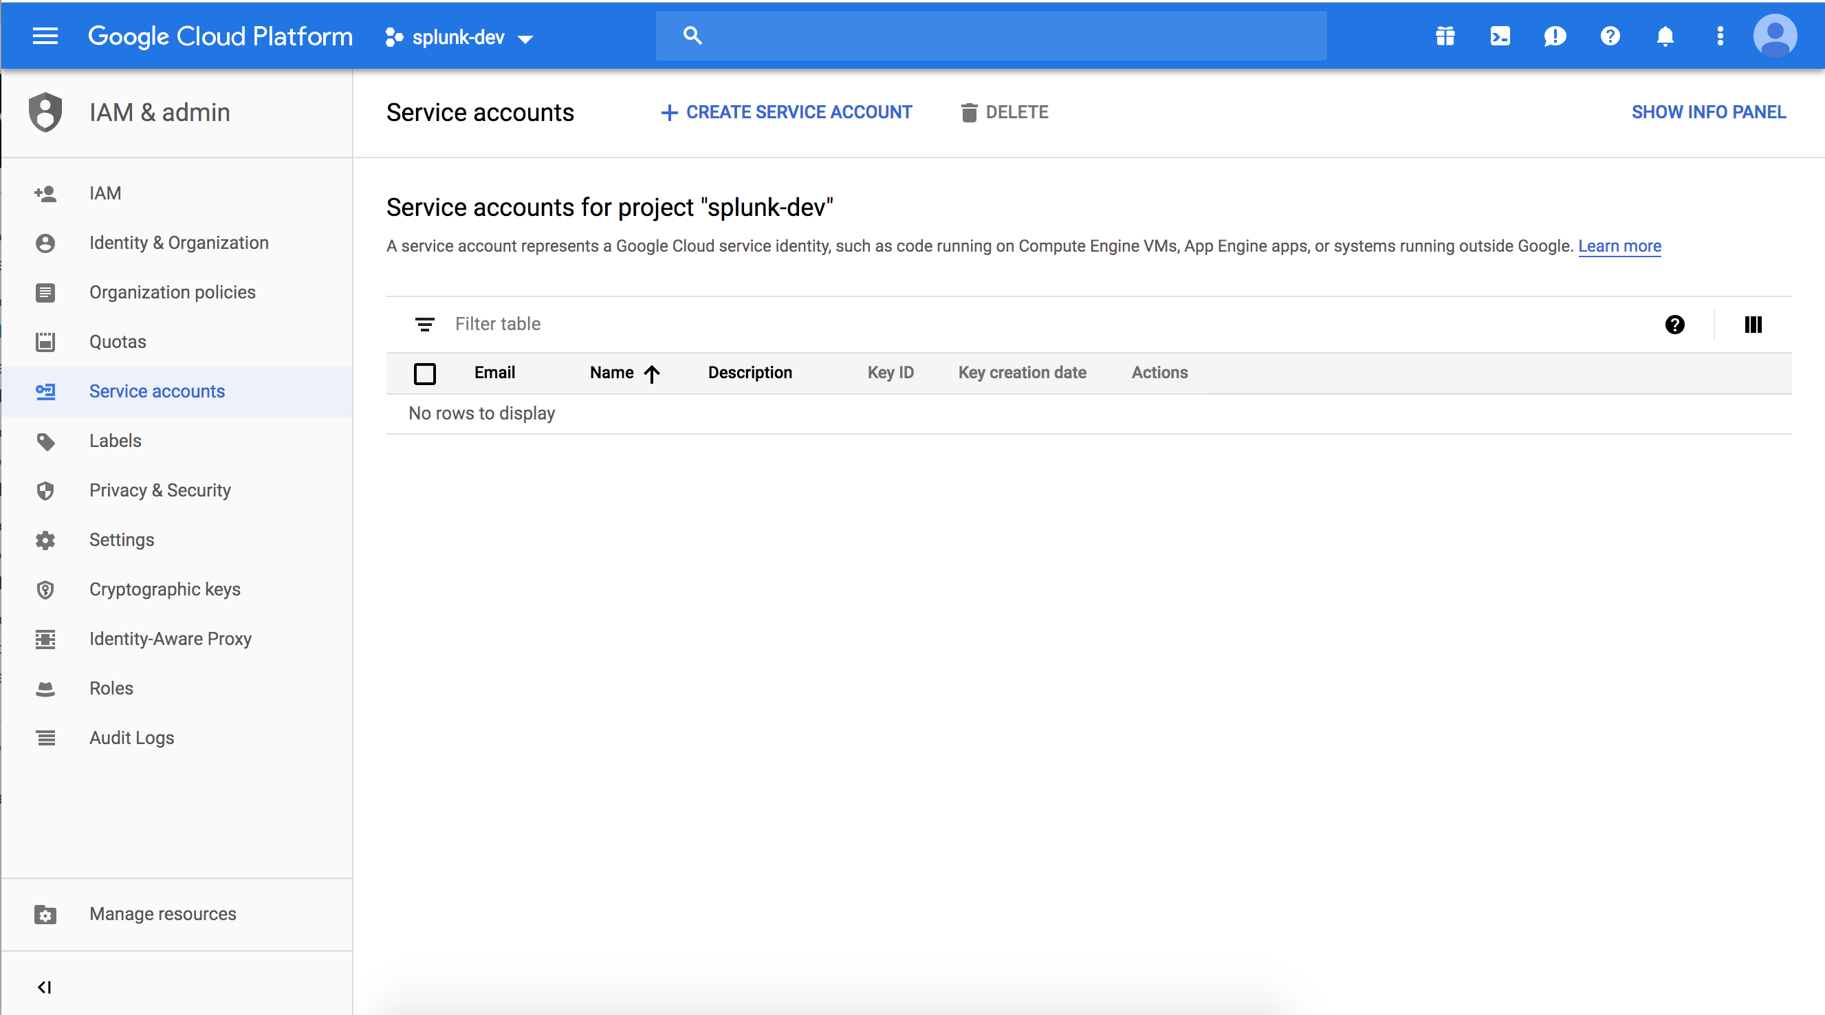
Creating a Service account – Part 2
Click Create Service Account
Click here
Notes:
Now that we are in the IAM & admin console, click on “Create Service Account”

Slide 14
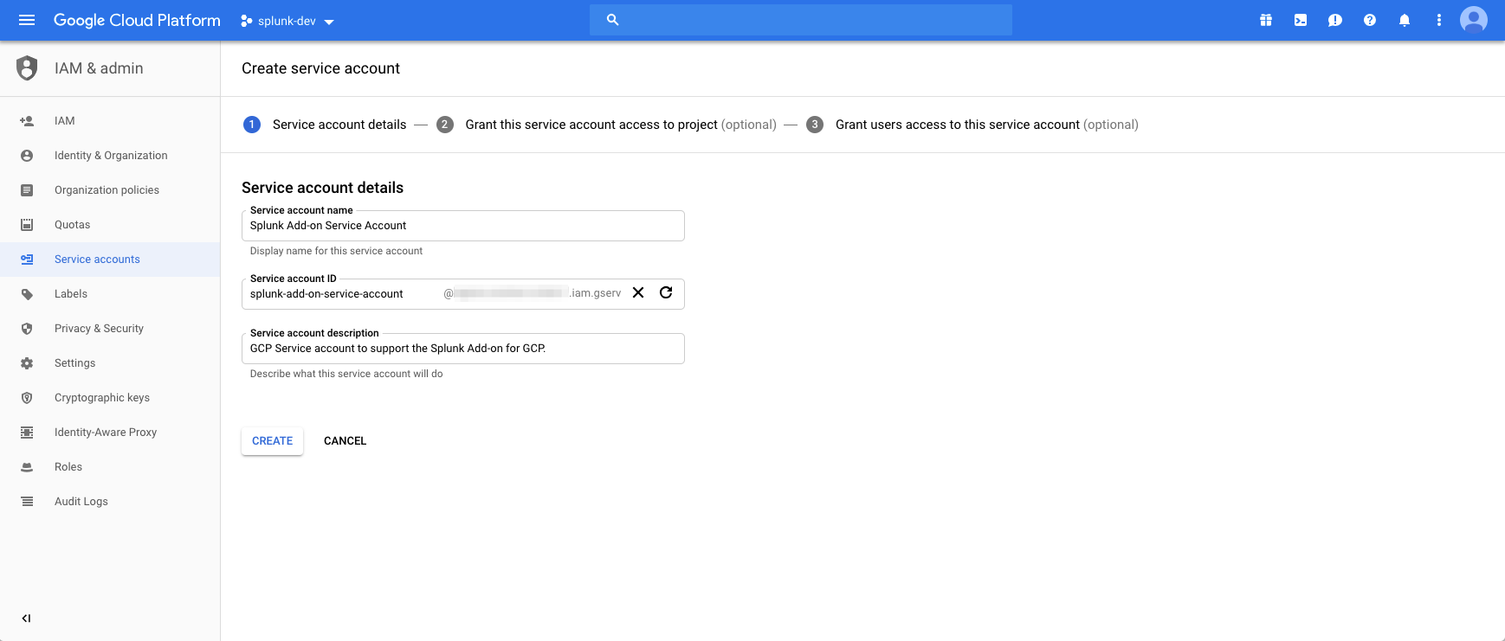
Creating a Service account – Part 2
Provide Service account name, Service account ID, Service account description

Slide 15
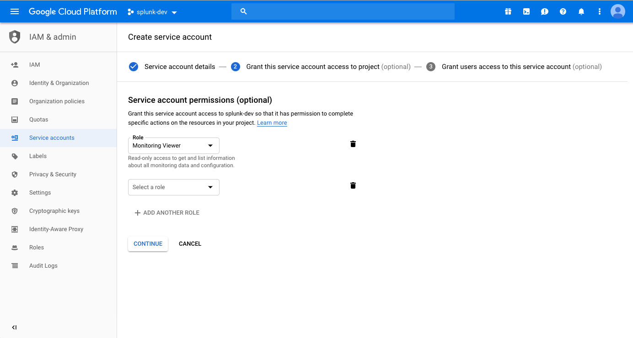
Adding permissions to a service account– Part 2.5
Add roles to service account – A breakdown of what roles to add to support which services is on the next slide. Additional roles can be added later if needed.

Slide 16
Adding permissions to a service account– Part 2.5
Simple breakdown of GCP services to required Service account roles. Add the following roles to your Service account.
Service: GCP Storage
Roles: (Custom Viewer Role, Storage -> Storage Object Viewer):
Role permission/s are used for the Billing report input
Service: GCP Monitoring
Roles: (Monitoring -> Monitoring Viewer):
Role permission/s are used for the Cloud Monitoring input
Service: GCP Pub/Sub
Roles: (Pub/Sub -> Pub/Sub Subscriber, Pub/Sub -> Pub/Sub Viewer):
Role permission/s are used for the Pub/Sub input

Slide 17
Adding permissions to a service account– Part 2.5
Custom Storage viewer role.
Don’t forget to Add the custom Storage viewer role created earlier to the Service account permissions!

Slide 18
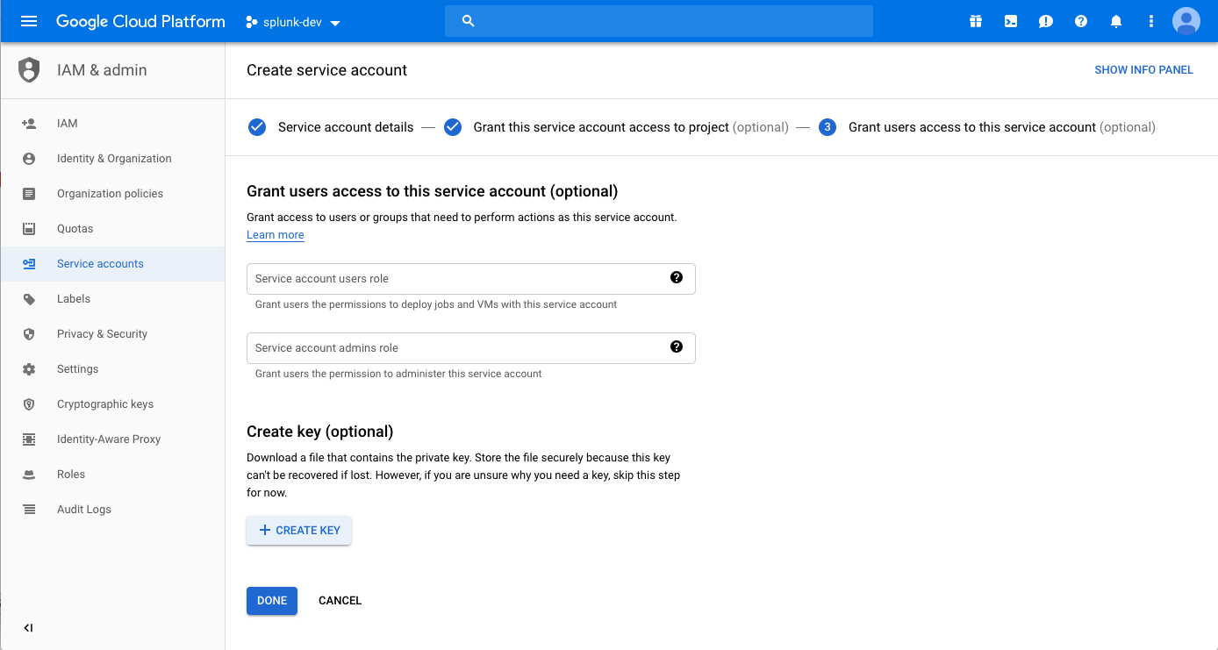
Creating a Service account – Part 3
Create the key used by the Splunk Add-on for GCP
Click here

Slide 19
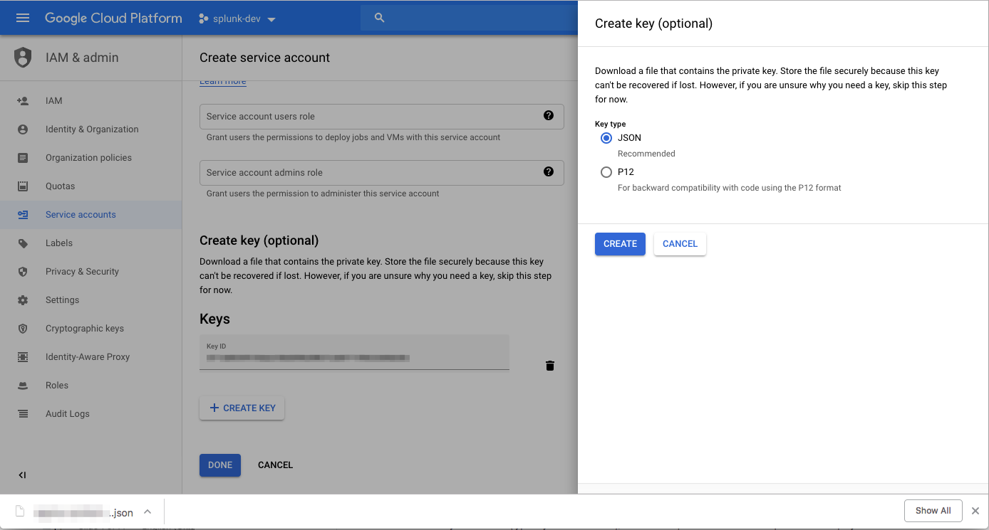
Create Service account – Part 3
Select JSON as your key type, create and download the key
Click here
Key is downloaded after creation

Slide 20
Creating a Service account – Part 3
Important note!
Keep track of the key generated and downloaded in this step. It will be needed during setup of the Splunk Add-on for GCP.
It is also worth copying the full email address of the Service account (format: my-service-account@my-project-123456.iam.gserviceaccount.com) to a temporary clipboard somewhere. You will need to copy paste this for future permissioning steps.

Slide 21
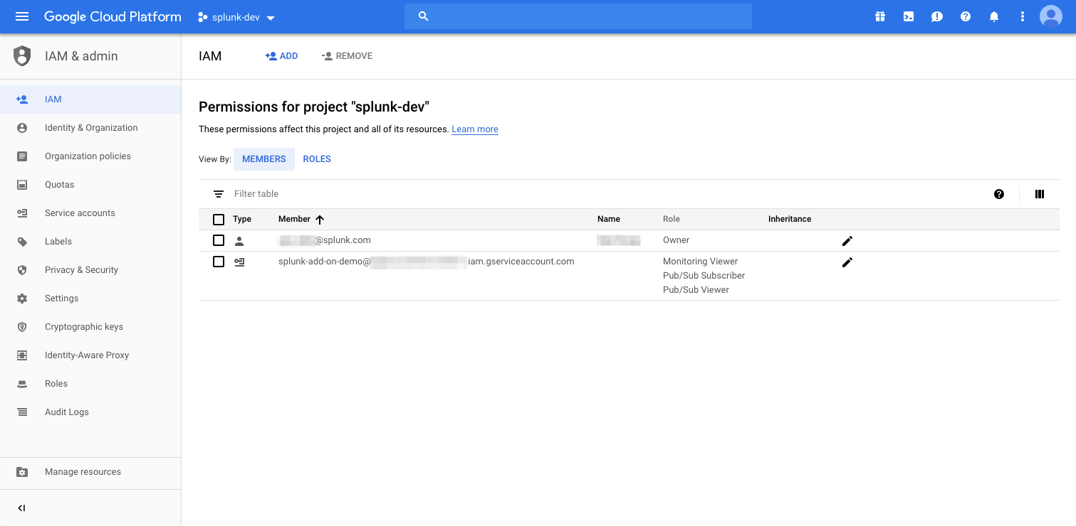
Editing Service account roles – Part 4 (Optional)
Editing Service account roles is done through the IAM console dashboard NOT the service account console
Click here
Click here to edit Service account roles

Slide 22
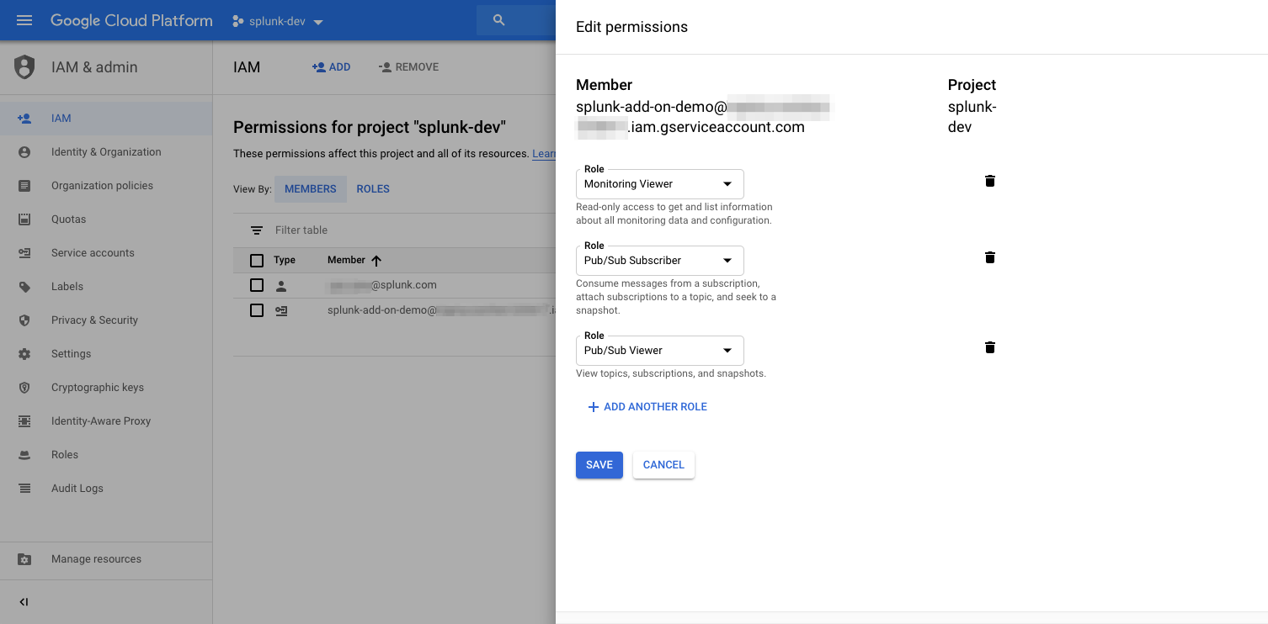
Editing Service account roles – Part 4 (Optional)
Add, remove, and modify roles attached to a service account

Slide 23
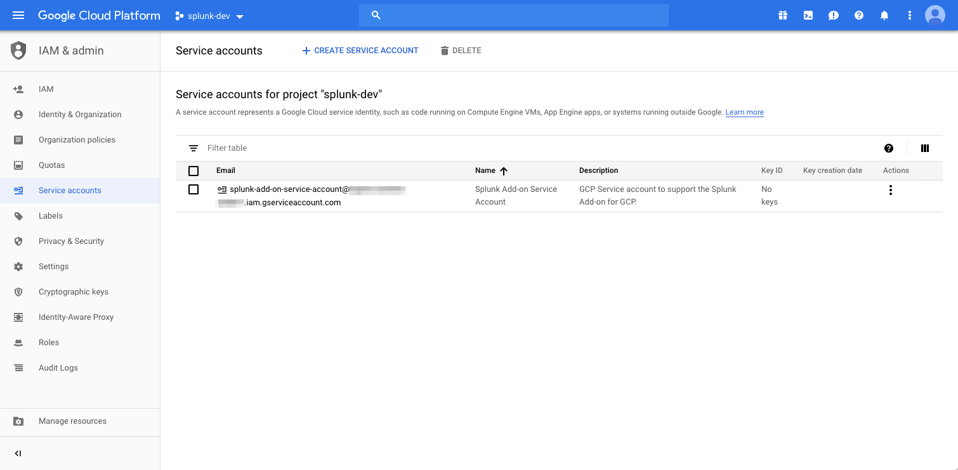
Generating Service account keys – Part 5 (Optional)
Generating Service account keys is done through the Service account console dashboard NOT the IAM console
Click here

Slide 24
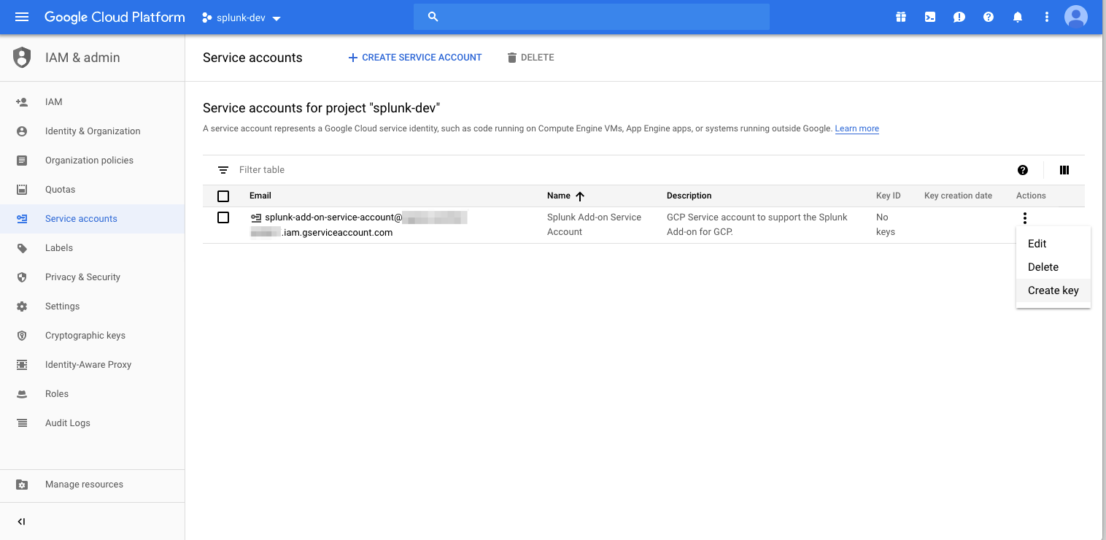
Generating Service account keys – Part 5 (Optional)
Under Actions, select Create key. Use Edit to change the Name or Description of the Service account
Click here

Slide 25
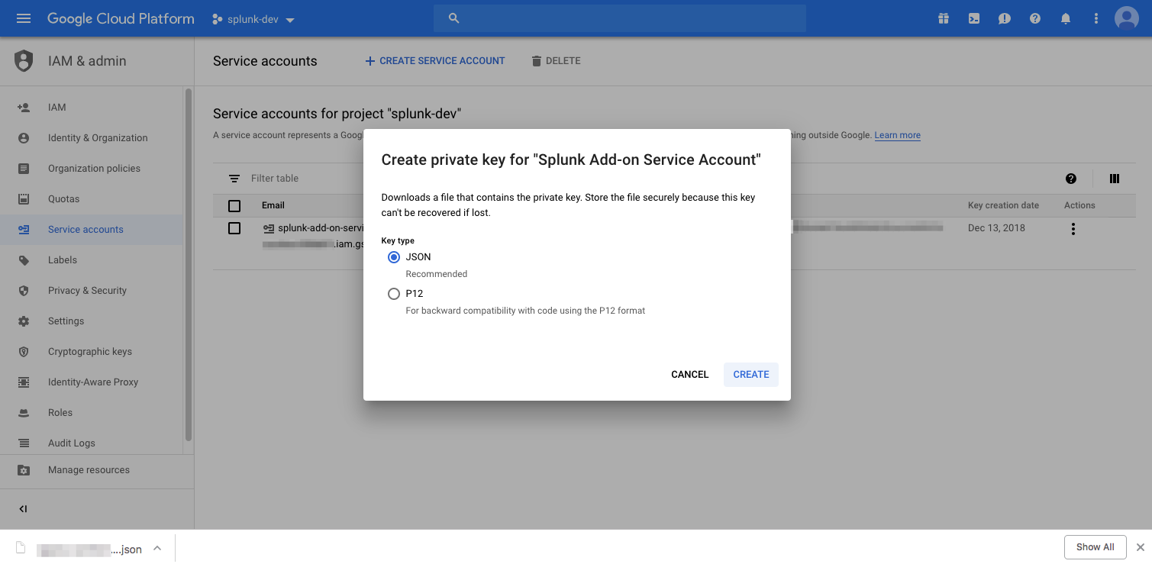
Generating Service account keys – Part 5 (Optional)
Select JSON as your key type, create and download the key
Click here
Key is downloaded after creation

Slide 26
Configure GCP services
For some GCP service data that Splunk Add-on for GCP can index, additional GCP-side configuration is required.

Slide 27
Table of Contents: GCP Setup
What’s in this section?
This section will walk through
Setting up GCP billing
Setting up GCP Monitoring
Setting up GCP Stackdriver log export
Setting up GCP Pub/Sub

Slide 28
Configure GCP billing export
To get your daily usage and cost estimates data in Splunk, you must enable billing export data.

Slide 29
Table of Contents: GCP billing export
What’s in this section?
This section will walk through
Creating a bucket in Google Cloud Storage
Permissioning the Cloud Storage Bucket
Configuration of GCP billing export

Slide 30
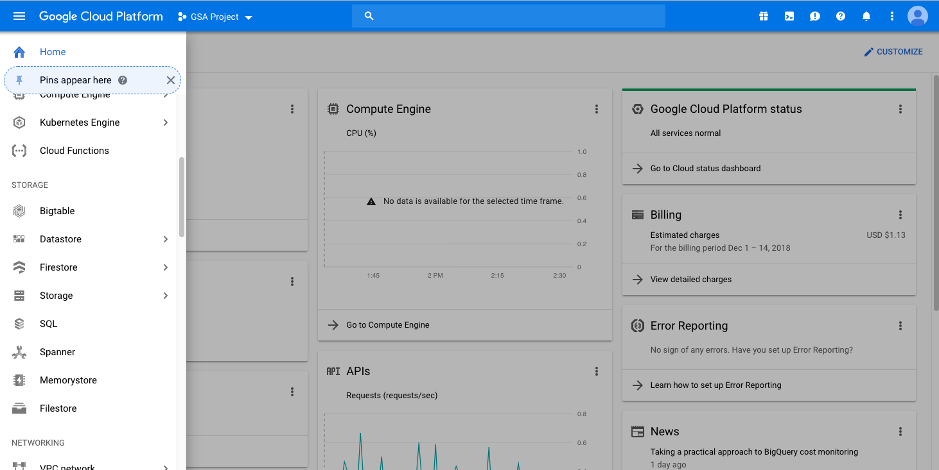
Creating a bucket in Google Cloud Storage - Part 1
From the GCP Service menu, scroll to Storage and click.
Click here

Slide 31
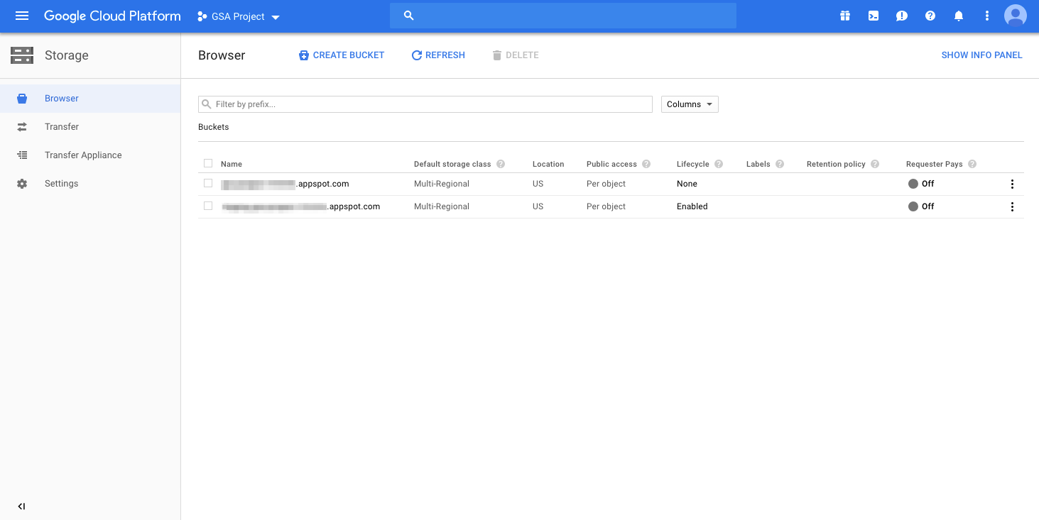
Creating a bucket in Google Cloud Storage - Part 1
Click Create Bucket
Click here

Slide 32
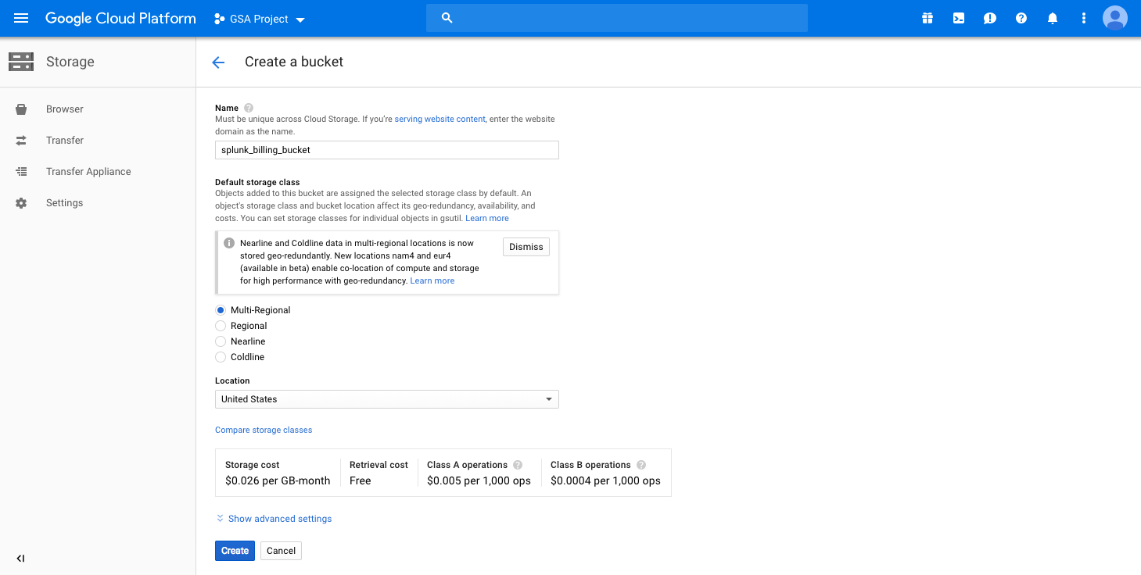
Creating a bucket in Google Cloud Storage - Part 1
Provide a name for the bucket and click Create. Keep track of this bucket name for the next part.

Slide 33
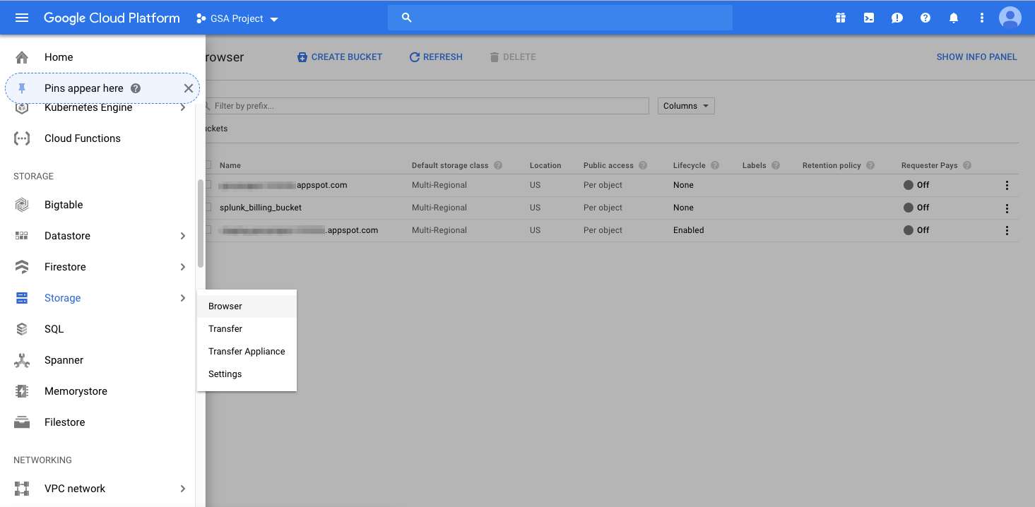
Permissioning the Cloud Storage Bucket - Part 2
From the GCP Service menu, scroll to Storage, hover and click Browser.
Here
Then click here

Slide 34
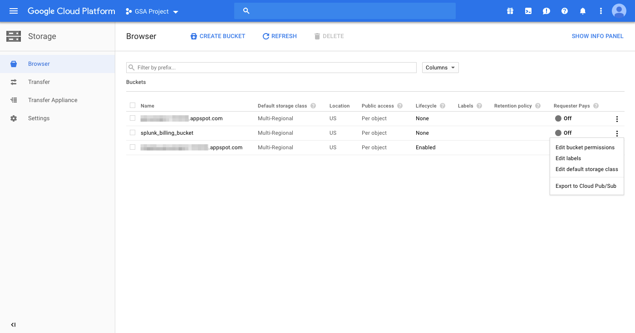
Permissioning the Cloud Storage Bucket - Part 2
Click on the menu dots on the far right of the bucket created for storing billing information in the previous step. Click edit bucket permissions.
Click here

Slide 35
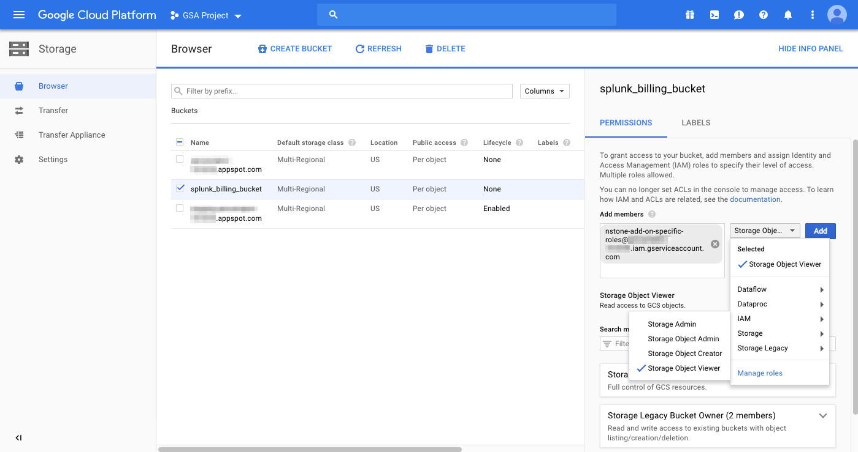
Permissioning the Cloud Storage Bucket - Part 2
Add the service account created in the first part of this module in the Add members field. Select the Storage Object Viewer Role under Storage

Slide 36
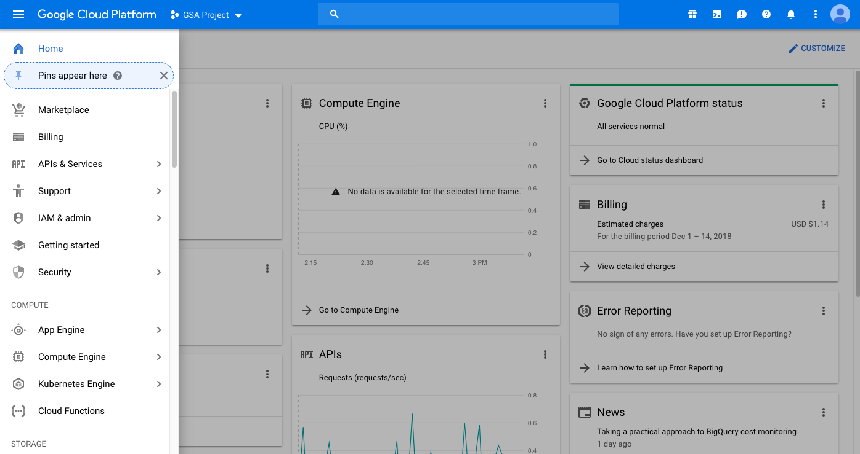
Configuration of GCP billing export - Part 3
From the GCP Service menu, scroll to Billing and click.
Click here

Slide 37
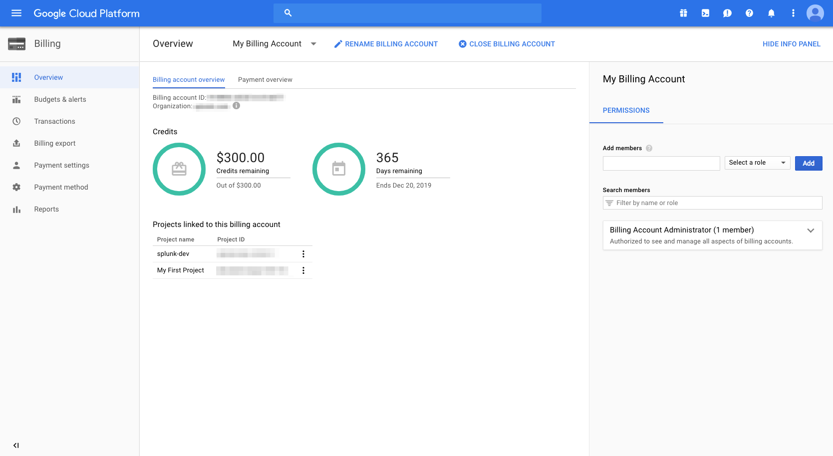
Configuration of GCP billing export - Part 3
Select Billing export
Click here

Slide 38
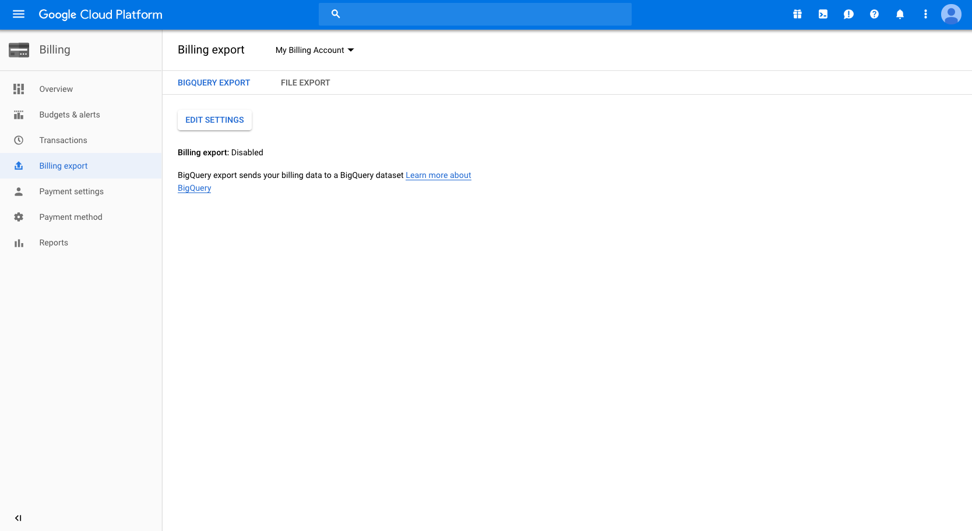
Configuration of GCP billing export - Part 3
Select File export
Click here

Slide 39
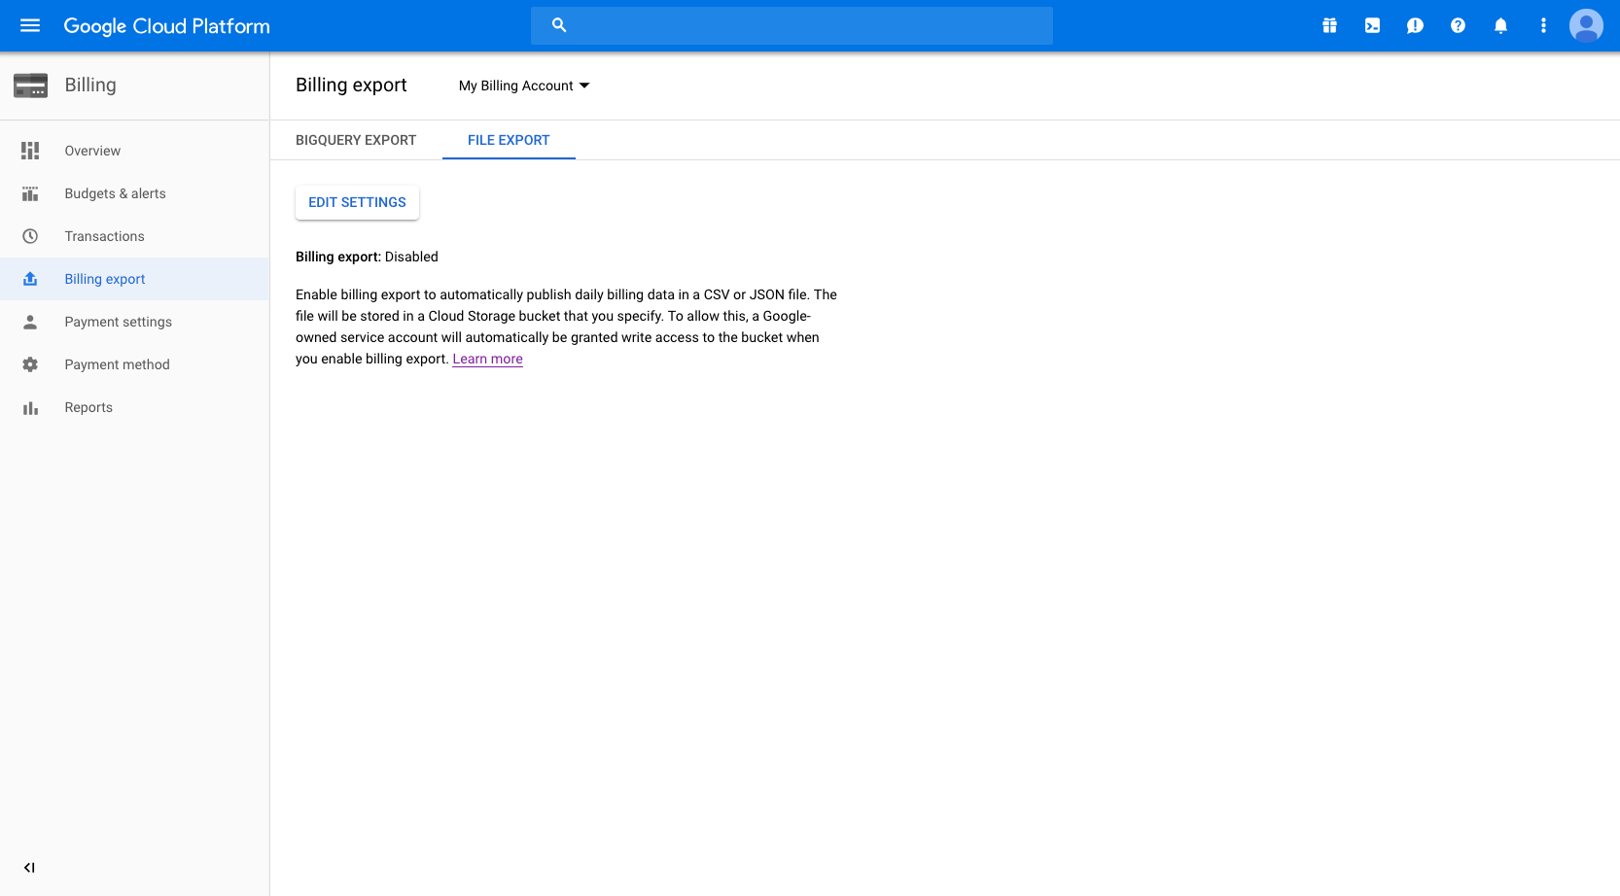
Configuration of GCP billing export - Part 3
There is no billing export currently enabled. Click Edit Settings to enable one and provide details about format to export the report as and what bucket to write to.
Click here

Slide 40
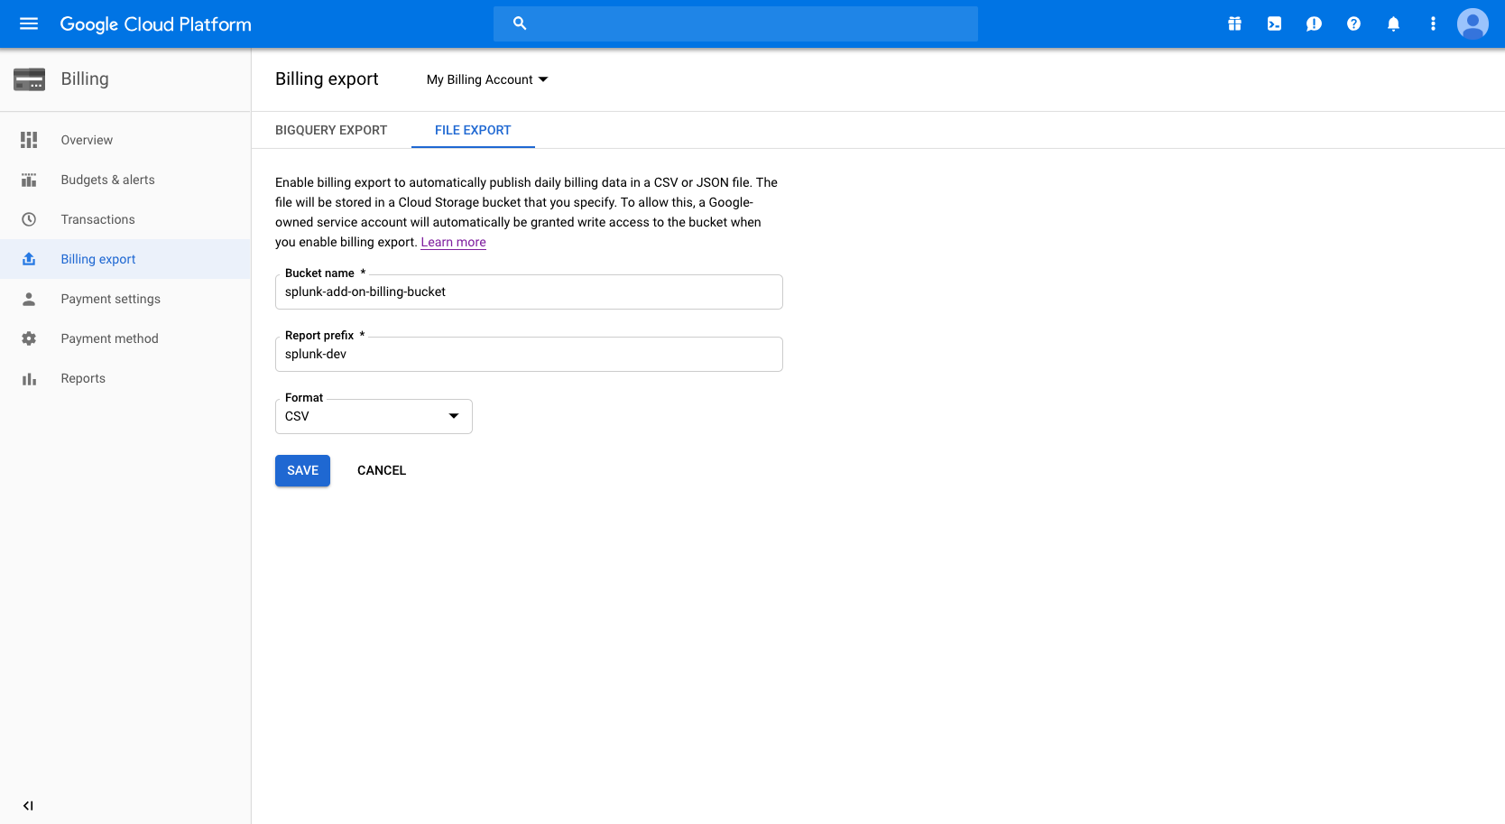
Configuration of GCP billing export - Part 3
Provide the name of the bucket created in the previous part, a report prefix (perhaps the project name or another distinguishing tag), a report format preference (both JSON and CSV are supported by the Add-on). Click Save.

Slide 41
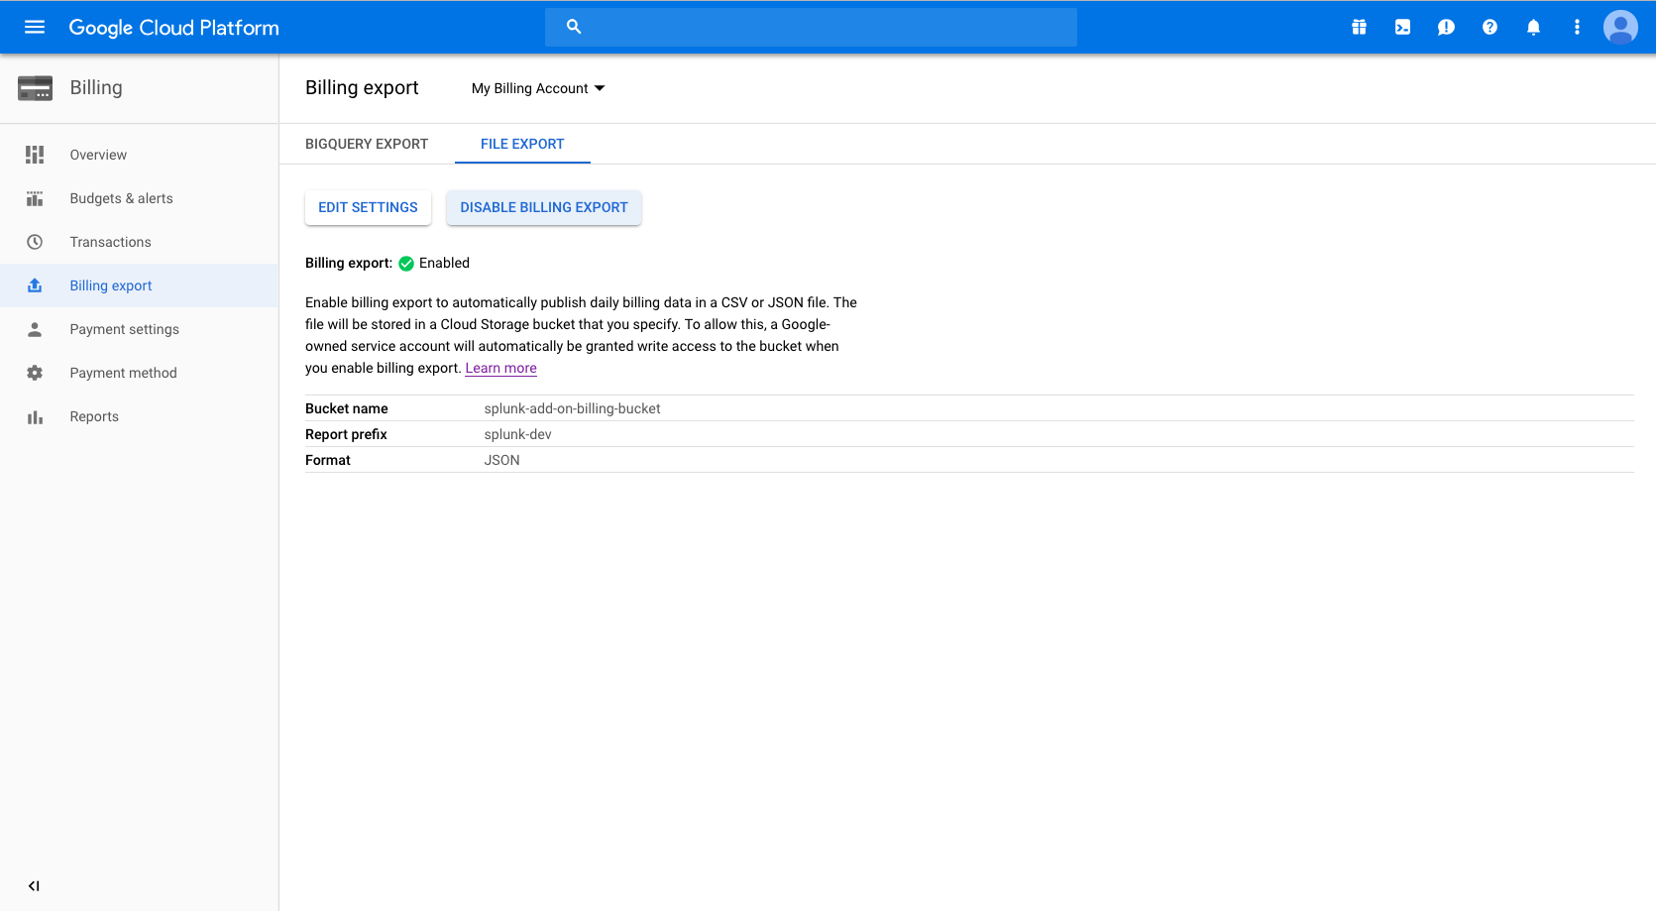
Configuration of GCP billing export - Part 3
The billing export should now show as enabled with the bucket, prefix, and format as provided. If needed, click Edit Settings to modify settings. Note that a permissioned GCP Service account has been created to write the report to the bucket on a daily interval.

Slide 42
Configure GCP Cloud Monitoring
Let’s double check our Service account permissions…

Slide 43
Table of Contents: GCP Cloud Monitoring
What’s in this section?
This section will walk through
Confirming GCP Service account permissions are correct

Slide 44
Confirming GCP Service account permissions are correct – Part 1
From the GCP Console Service menu, scroll to IAM & Admin, hover and click IAM
Here
Then click here
Notes:
Let’s start by opening the GCP menu, selecting IAM & admin and clicking on the Service accounts option on the left hand side.

Slide 45
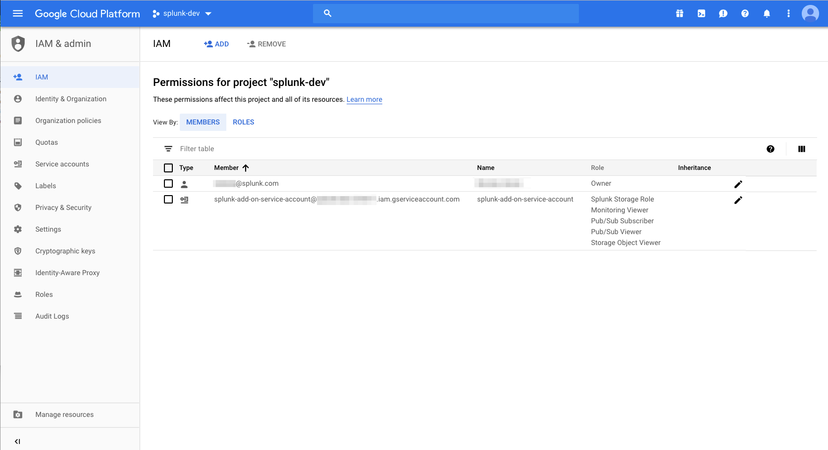
Service account roles for GCP Cloud Monitoring
Confirm the GCP Service account created for the Add-on has the Monitoring Viewer Role assigned for collecting Cloud Monitoring metrics
Confirm Monitoring Viewer role assigned here

Slide 46
Configure Pub/Sub
Depending on how you plan to use Pub/Sub, you may need to configure a few items before the Splunk Add-on for GCP can access your Pub/Sub data

Slide 47
Table of Contents: Configuring Cloud Pub/Sub
What’s in this section?
This section will walk through
Introducing how Splunk integrates with Pub/Sub
Setting up a Cloud Pub/Sub topic and subscription

Slide 48
Splunk and Pub/Sub
How do they integrate?
The Splunk Add-on for GCP can pull from correctly configured Pub/Sub topics and subscriptions.
Splunk can ingest events from any GCP service that sends to Pub/Sub by subscribing to the correct Pub/Sub topic.

Slide 49
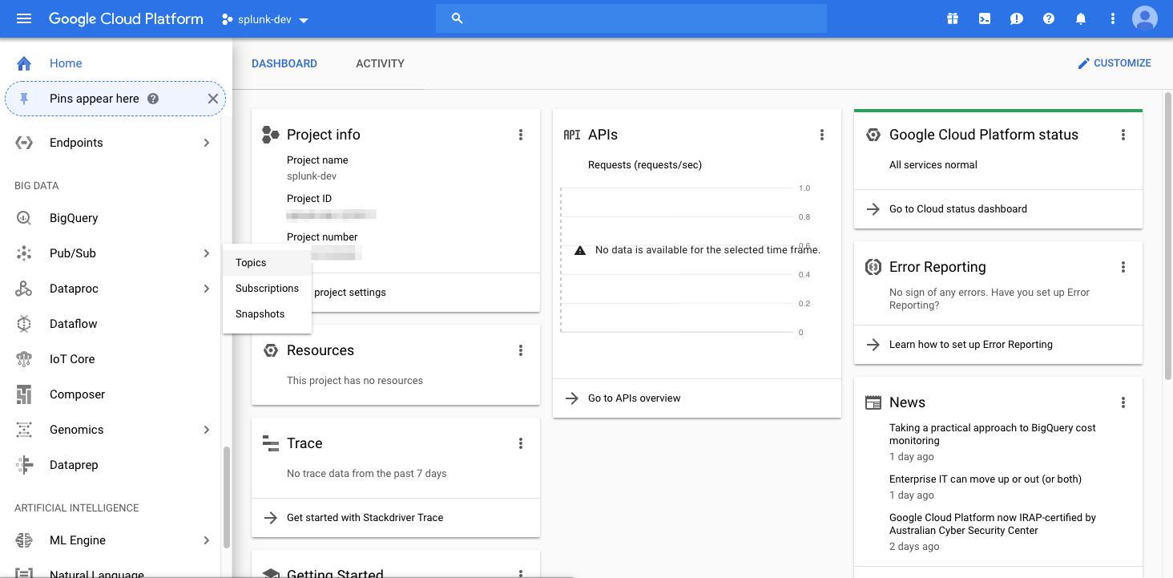
Setting up a Cloud Pub/Sub topic
From the GCP Service menu, scroll to Pub/Sub, click and select Topics
Here
Then click here

Slide 50
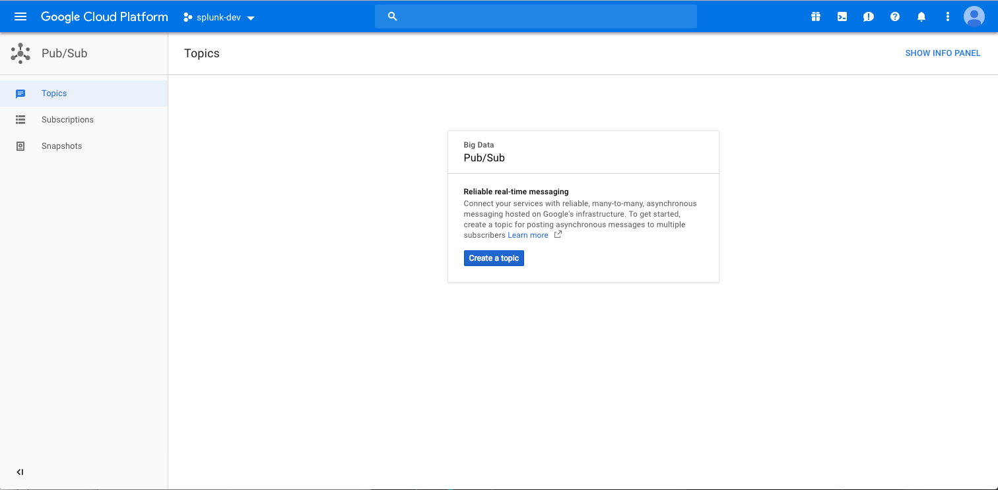
Setting up a Cloud Pub/Sub topic
If Pub/Sub is not configured, first click enable API. After, click Create a topic
Click here

Slide 51
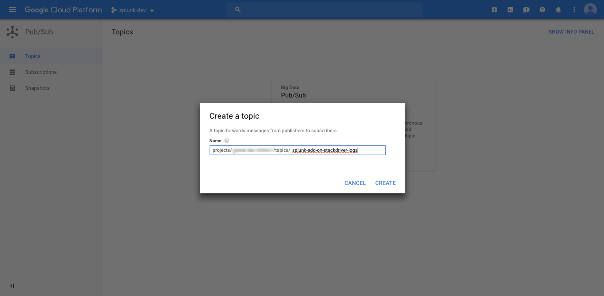
Setting up a Cloud Pub/Sub topic
Name your topic and click Create

Slide 52
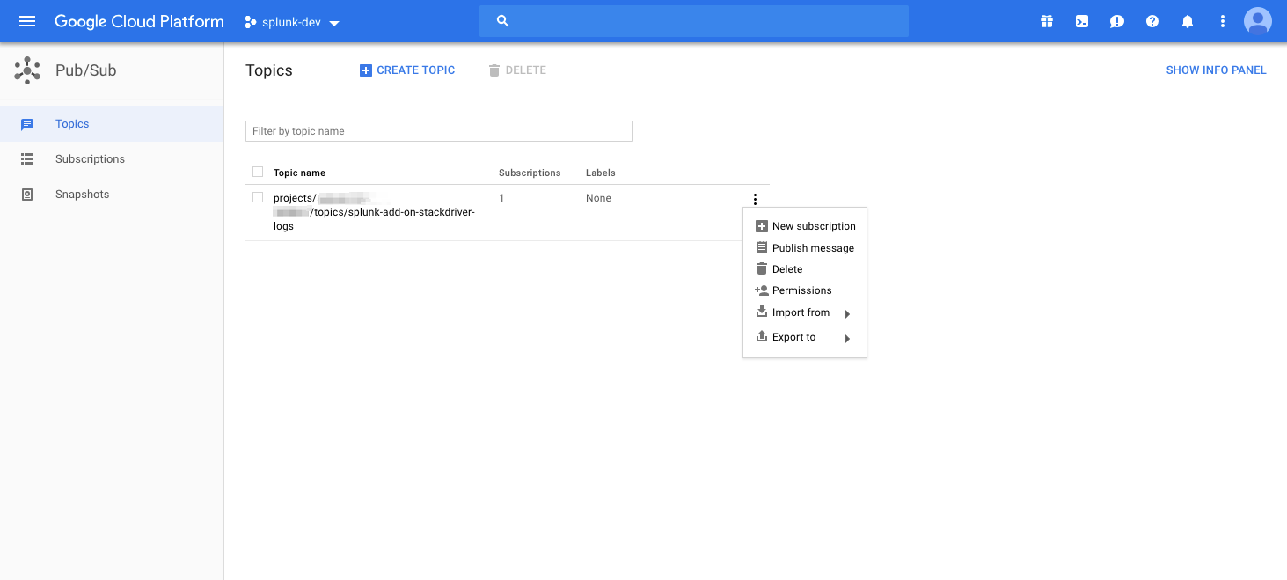
Setting up a Cloud Pub/Sub topic
Create a new subscription for the topic that was just created
Click here

Slide 53
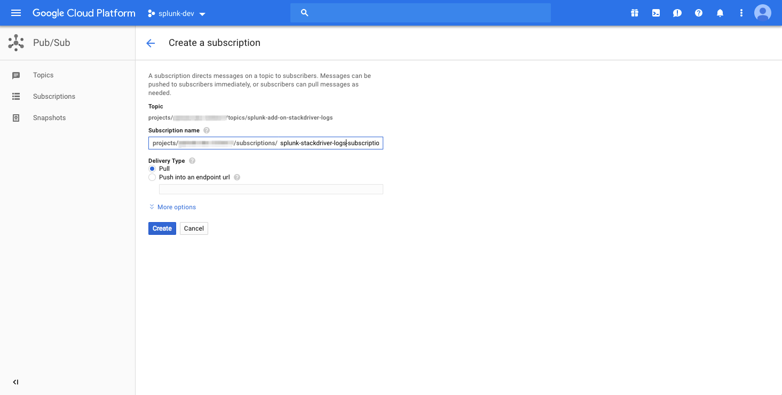
Setting up a Cloud Pub/Sub topic
Provide a name for the subscription and click Create
Click here

Slide 54
Configure Stackdriver logging
To setup Stackdriver logs for Splunk ingestion, you must configure Stackdriver logging to send logs to a GCP Pub/Sub topic.

Slide 55
Table of Contents: Configuring Stackdriver logging
What’s in this section?
This section will walk through
Setting up a Cloud Pub/Sub topic
Turning on audit logging for all services
Configuring the logging export
Setting IAM policy permissions for the Cloud Pub/Sub topic

Slide 56
Setting up a Cloud Pub/Sub topic – Part 1
From the GCP Console Service menu, scroll to Pub/Sub, click and select Topics
Here
Then click here

Slide 57
Setting up a Cloud Pub/Sub topic – Part 1
If Pub/Sub is not configured, first click enable API. After, click Create a topic
Click here

Slide 58
Setting up a Cloud Pub/Sub topic – Part 1
Name your topic and click Create

Slide 59
Setting up a Cloud Pub/Sub topic – Part 1
Create a new subscription for the topic that was just created
Click here

Slide 60
Setting up a Cloud Pub/Sub topic – Part 1
Provide a name for the subscription and click Create
Click here

Slide 61
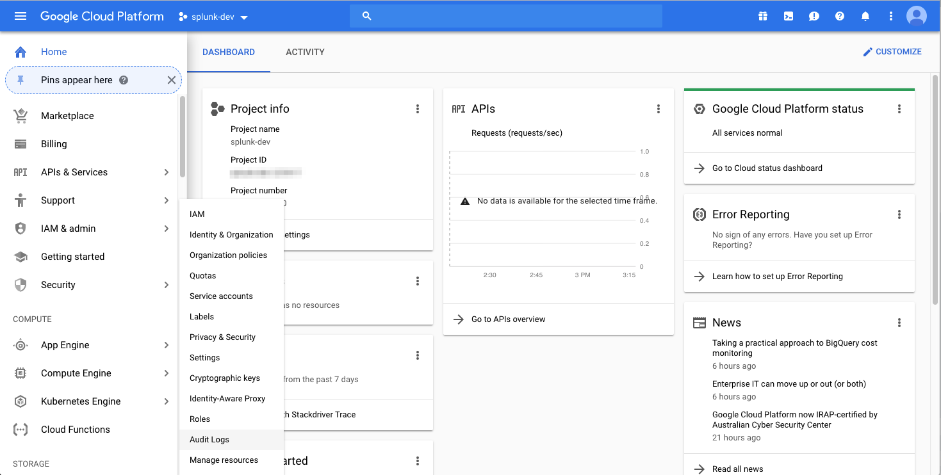
Turn on audit logging for GCP services – Part 2
From the GCP Service menu, scroll to IAM & Admin, click and select Audit Logs
Here
Then click here

Slide 62
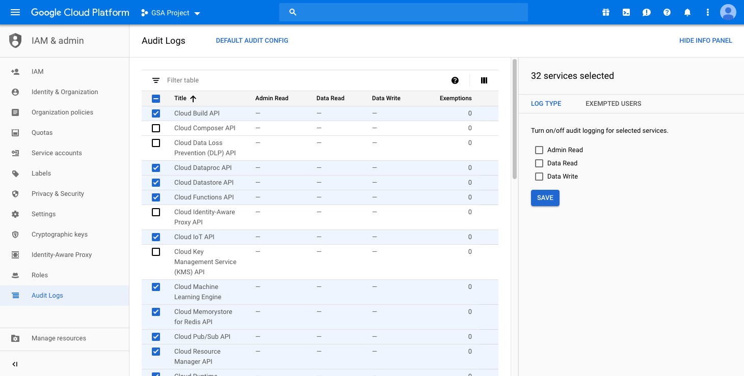
Turn on audit logging for all services – Part 2
Select the checkboxes for GCP services for which you would like to enable Audit Logs.
Select services here

Slide 63
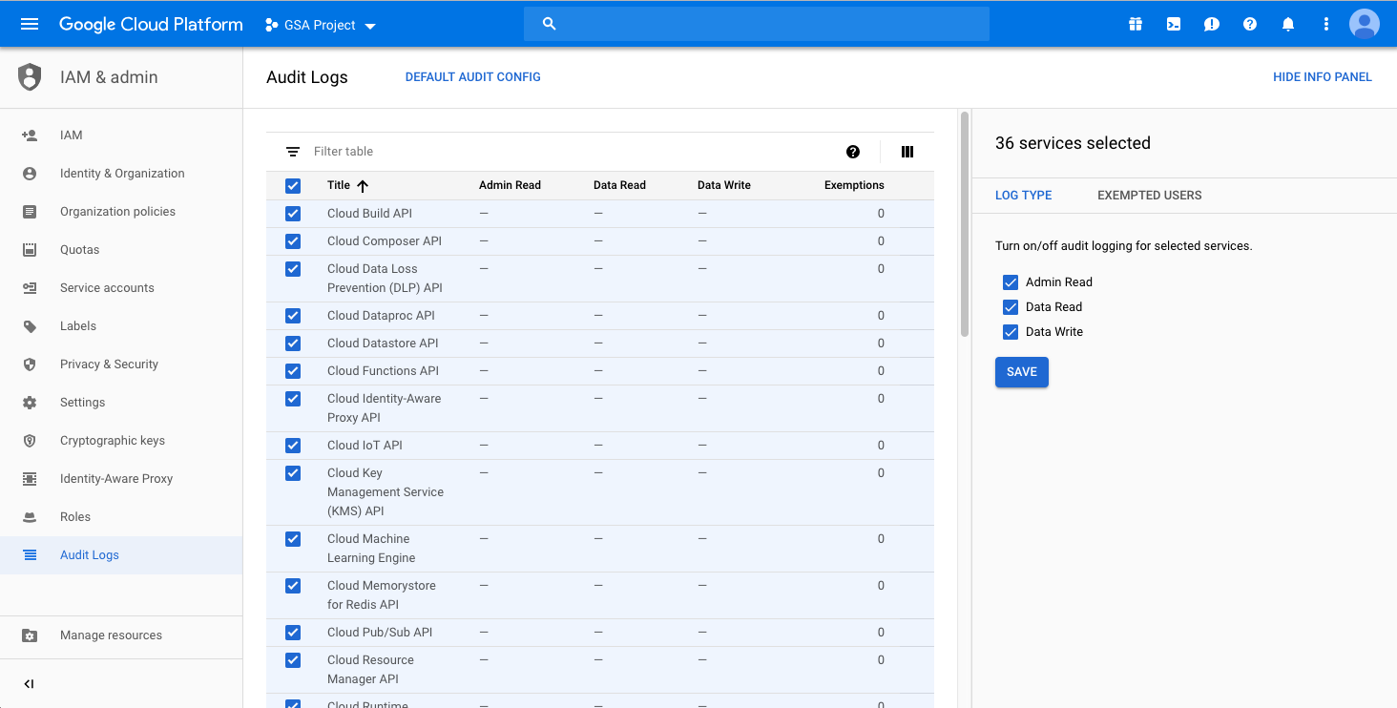
Turn on audit logging for all services – Part 2
Once you have made your service selections, select from (Admin Read, Data Read, Data Write) to specify which types of actions you would like to audit. Click Save after making your selections. The next slide explains what these log types mean.
Select audit log type here

Slide 64
Turn on audit logging for all services – Part 2
What do these mean? -> (Admin Read, Data Read, Data Write)
Admin Read: Admin Activity logs contain log entries for API calls or other administrative actions that modify the configuration or metadata of resources.
Data Read: System Event logs contain log entries for when Compute Engine performs a system event.
Data Write: Data Access audit logs record API calls that create, modify, or read user-provided data.
Read more here: https://cloud.google.com/logging/docs/audit/

Slide 65
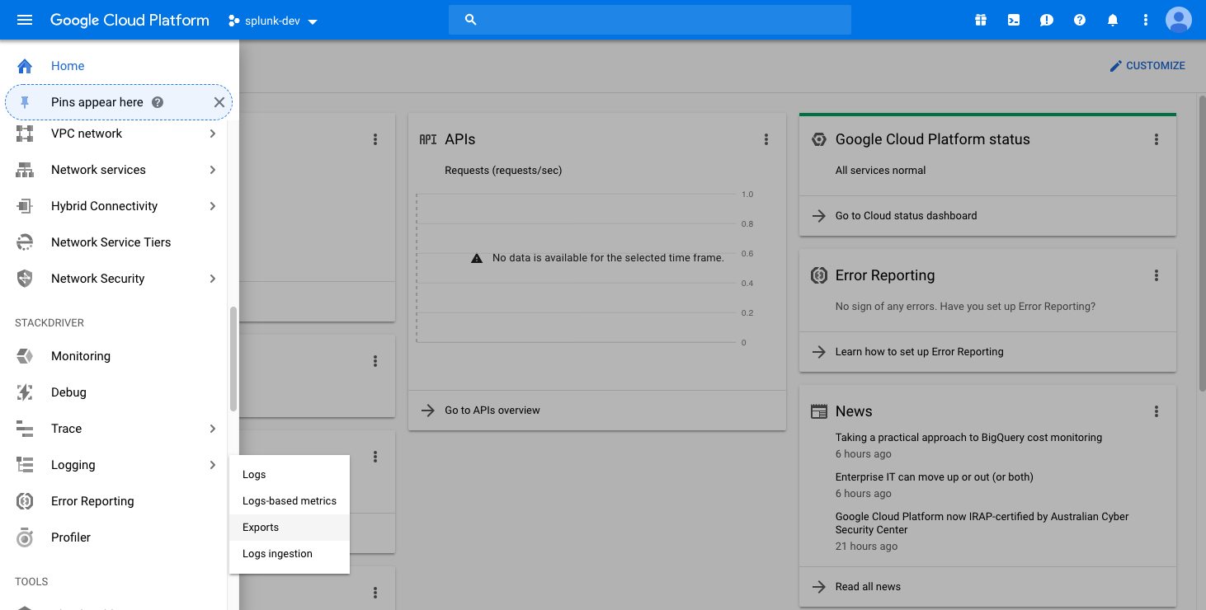
Configure the logging export – Part 3
From the GCP Console Service menu, scroll to Logging, click and select Exports
Here
Then click here

Slide 66
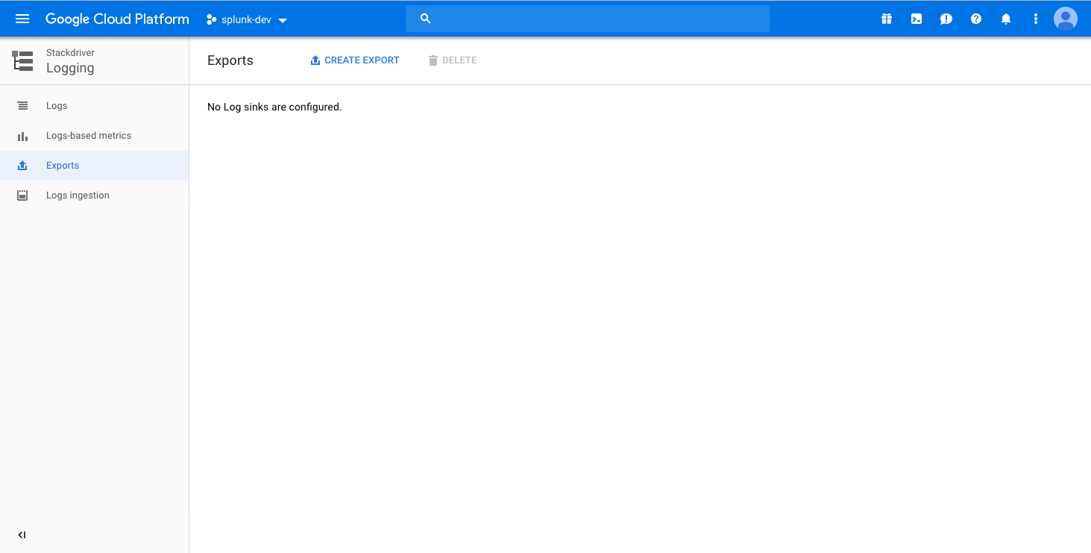
Configure the logging export – Part 3
Select Create Export to create a log sink
Click here

Slide 67
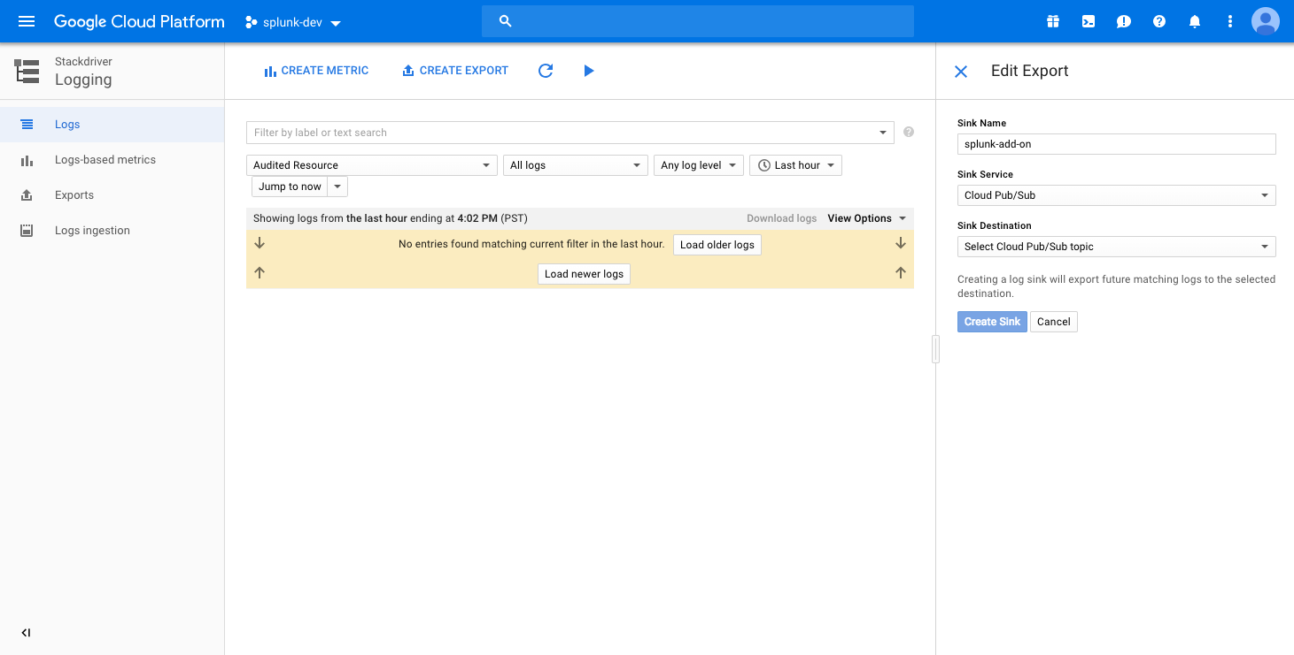
Configure the logging export – Part 3
Fill out Sink Name, Sink Service (Cloud Pub/Sub), and Sink Destination (The topic created in Part 2). Click Create Sink.

Slide 68
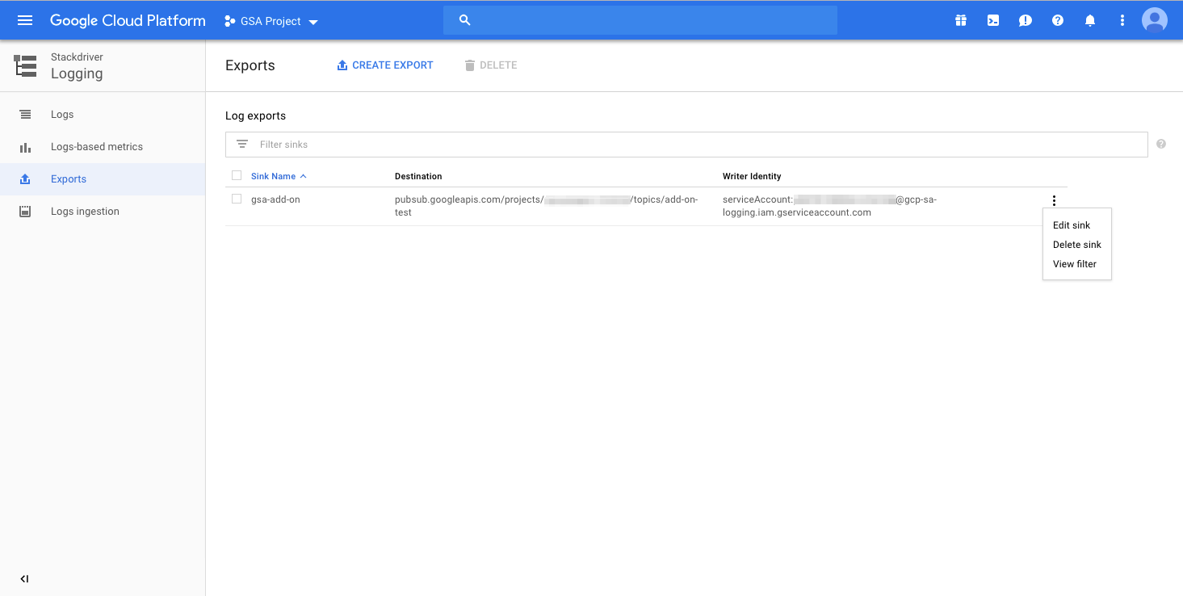
Configure the logging export – Part 3
Add any required filters to the export.
Click here

Slide 69
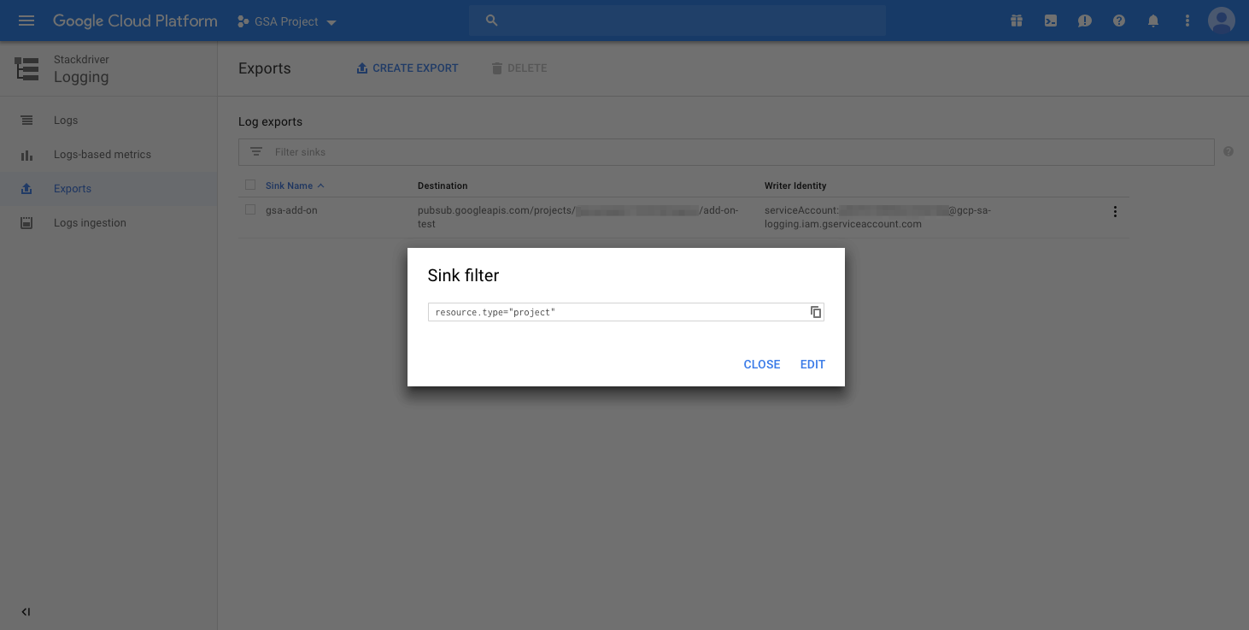
Configure the logging export – Part 3
Check the sink filter string. Click Edit if needed.

Slide 70
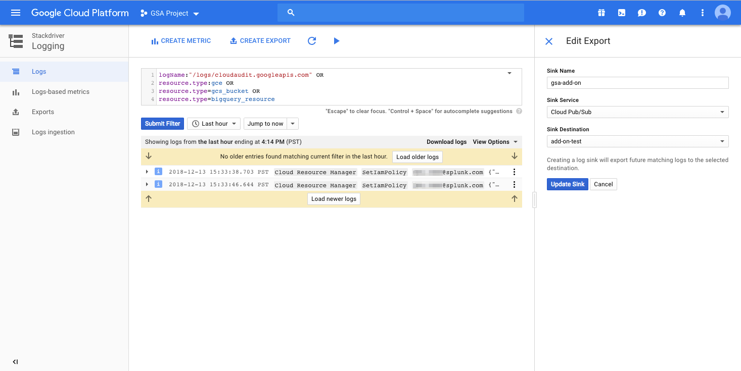
Configure the logging export – Part 3
Edit the filter string and click Submit Filter to validate syntax. Click Update Sink when satisfied with filter results. Filter syntax is detailed in the next slide.
Edit filter here
Validate filter
Submit filter edit

Slide 71
Configure the logging export – Part 3
Basic syntax for creating log export filters
unicorn phoenix
Finds all log entries containing unicorn or phoenix, in the same or different field(s).
status:200
View log entries with a status (field) of (exactly) 200 (value).
A space in between query (ex. unicorn phoenix status:200) signifies or
Wrap query in quotes for string literal (“unicorn phoenix”)
- (minus sign) in front of a string excludes the string from the returned results
* Does NOT mean wildcard
OR, AND, NOT, etc. Boolean operators are not supported
Basic filter syntax fully detailed here
https://cloud.google.com/logging/docs/view/basic-filters

Slide 72
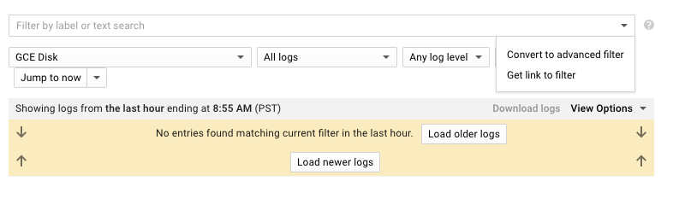
Configure the logging export – Part 3
Advanced filter syntax for creating log export filters
Advanced filters provide support for wildcards, Boolean operators, grouping, greater than/less than comparison, regex-like logical parsing, and more.
Basic example of advanced filter syntax:
Using advanced filter syntax requires converting the search filter to and advanced filter
Advanced filter syntax fully detailed here:
https://cloud.google.com/logging/docs/view/advanced-filters
resource.type = "gce_instance" AND severity >= ERROR AND NOT textPayload:robot
Convert to advanced filter here

Slide 73
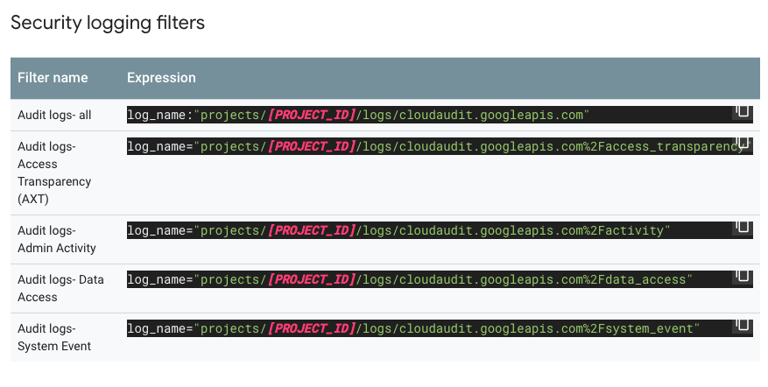
Configure the logging export – Part 3
Advanced filter library
Stackdriver logging provides a library of common filters that can be used to specify specific services and/or types of events. Mix and match as needed!
For example, see the example Security logging filters from the library below.
Complete filter list provided here:
https://cloud.google.com/logging/docs/view/filters-library

Slide 74
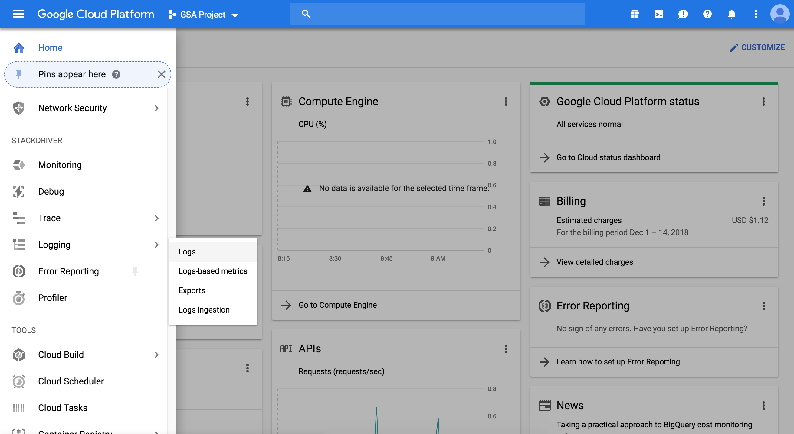
Configure the logging export – Part 3.5
Get the logging sink Writer Identity/Service account
The Service account created for interacting with the logging sink needs correct IAM permissions before it can begin writing to the Pub/Sub topic.
Click here

Slide 75
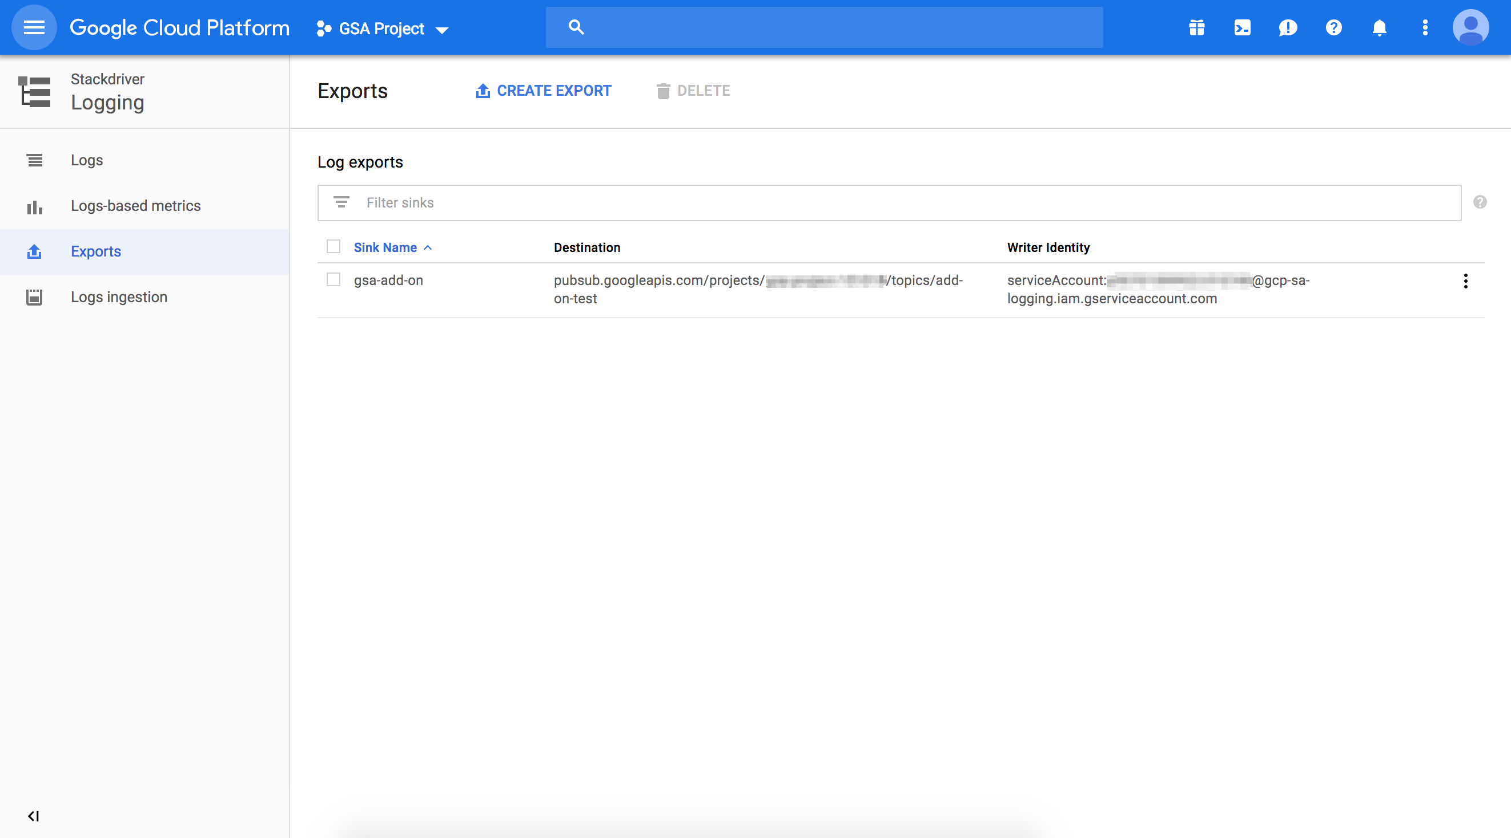
Configure the logging export – Part 3.5
Get the logging sink Writer Identity/Service account. Keep track of this service account, you will need it in the next part
Click here

Slide 76

Set IAM policy permissions for the Cloud Pub/Sub topic – Part 4
From the GCP Service menu, scroll to Pub/Sub, click and select Topics
Here
Then click here

Slide 77
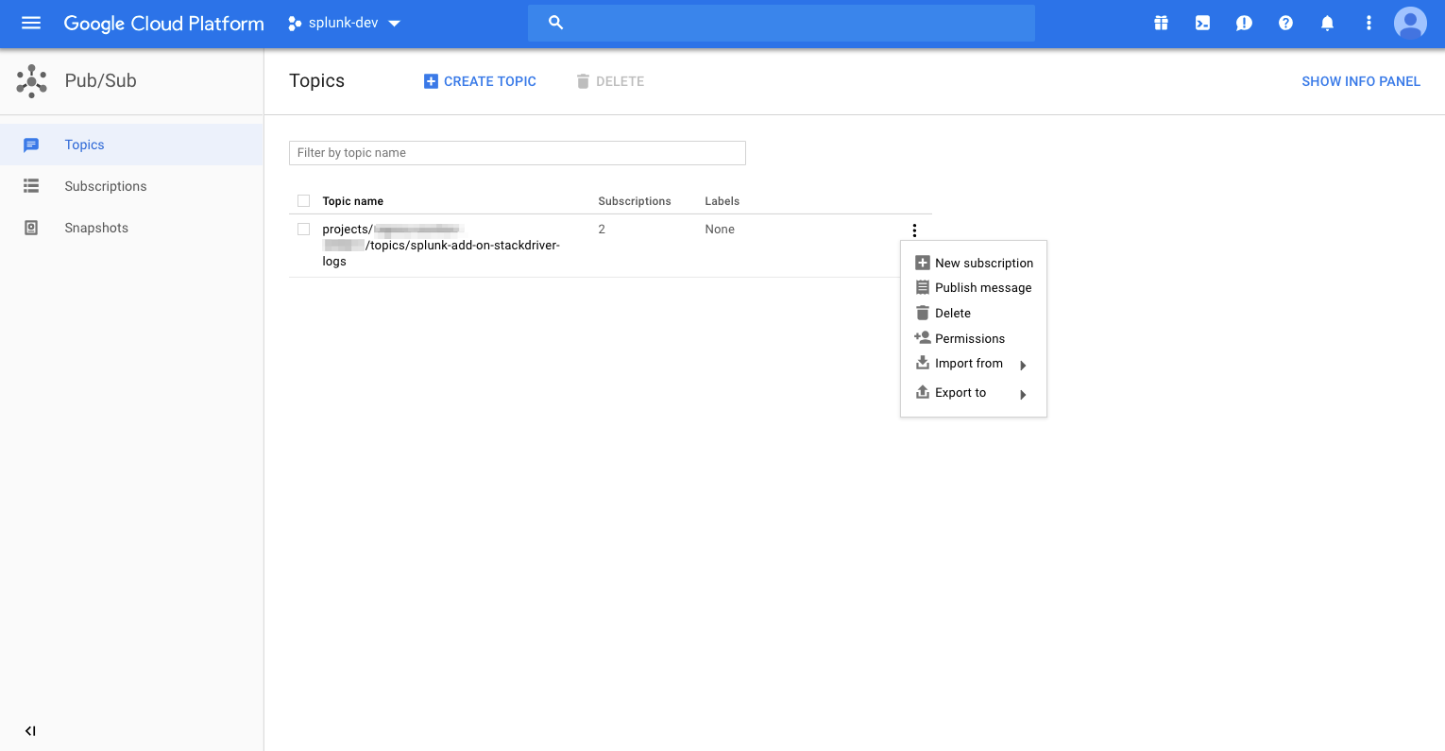
Set IAM policy permissions for the Cloud Pub/Sub topic – Part 4
Select Permissions for the Pub/Sub topic that you created in the previous part
Click here

Slide 78
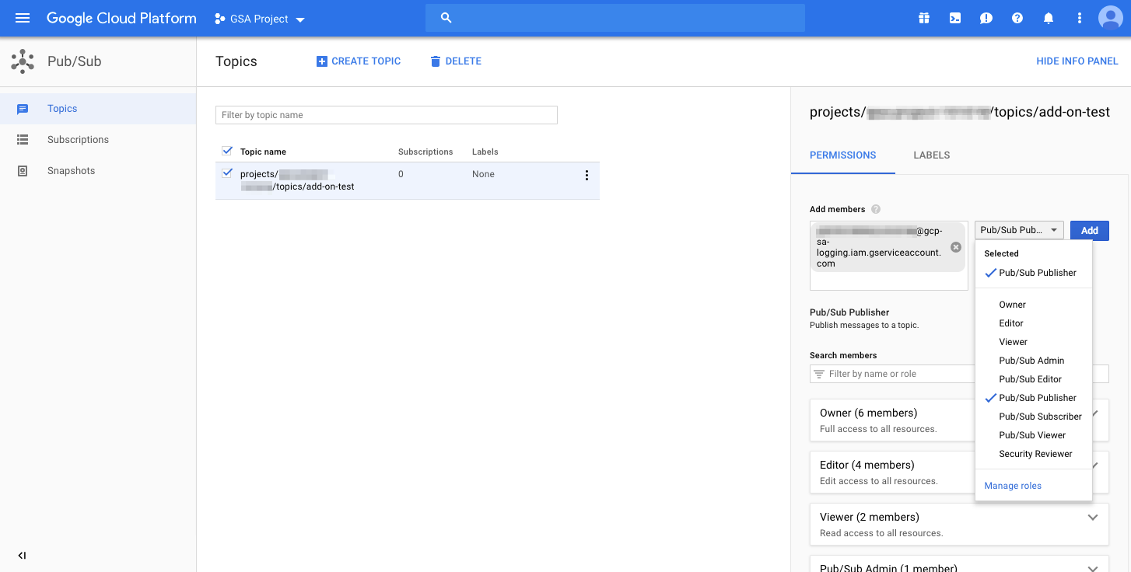
Set IAM policy permissions for the Cloud Pub/Sub topic – Part 4
Provide the Service account created for the logging export from the previous part and select Pub/Sub Publisher for the role
Log export Service account goes here
Select the Pub/Sub Publisher role

Slide 79
Summary: GCP Setup
Summary for GCP Setup
After completing this module you should have:
GCP Service account with correct roles attached
GCP Service account key (JSON file)
GCP Stackdriver log set up
GCP Cloud Monitoring set up
GCP Billing set up
GCP Pub/Sub set up
Once the GCP environment is setup, you can continue configuring the data ingest entirely in the Splunk Add-on for GCP.
Notes:
After completing the steps above, you should now have all the GCP Services sending data into buckets, Pub/Sub topics or available through REST. You are now ready to hook up Splunk and start collecting this data!

Slide 80
Continue to Module 2: Configuring the Splunk Add-on for GCP

